Slide 1
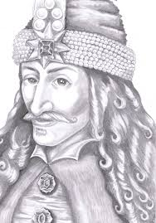
Vlad the Impaler

Slide 2
Born: 1431 in Sighisoara, Transylvania
Dracula: “Son of the Dragon”
Second child of Vlad II Dracul, voivode of Walachia
Walachia: principality between the Danube and the Transylvanian Alps in southern Romania
Voivode (prince and military leader) for 3 separate periods: 1448, 1456-1462, and 1476
To Romanians: Vlad Tepes (Vlad the Impaler)
To Turks: Kaziglu Bey (the Impaler Prince)
Impalement: preferred method of execution

Slide 3
Vlad was born in Sighisoara , Voivodeship of Transylvania, in the winter of 1431 future voivode of Wallachia. Vlad's father was the son of the celebrated Voivode Mircea the Elder. His mother is unknown, though at the time his father was believed to have been married to Princess Cheajna of Moldavia(eldest daughter of Alexander ,,the Good ,, Prince of Moldavia and aunt to Stephen the Great of Moldavia) He had two older half-brothers, Mircea II and Vlad Călugărul, and a younger brother, Radu III the Handsome.

Slide 4
Romanian and Bulgarian documents from 1481 onwards portray Vlad as a hero, a true leader, who used harsh yet fair methods to reclaim the country from the corrupt and rich boyars. Moreover, all his military efforts were directed against the Ottoman Empire which explicitly wanted to conquer Wallachia.
An Italian writer, Michael Bocignoli from Ragusa, in his writings from 1524, refers to Vlad Țepeș as: It was once (in Valahia), a prince Dragul by his name, a very wise and skillful man in war. (In Latin in the original text: Inter eos aliquando princeps fuit, quem voievodam appellant, Dragulus nomine, vir acer et militarium negotiorum apprime peritus.)
In the Letopisețul cantacuzinesc ("Cantacuzino chronicle"), a historic account written around 1688 by Stoica Ludescu of the Cantacuzino family, Vlad orders the boyars to build the fortress of Poenari with their own bare hands. Later in the document, Ludescu refers to the (re)crowning of Vlad as a happy event:Voievod Vlad sat on the throne and all the country came to pay respect, and brought many gifts and they went back to their houses with great joy. And Voievod Vlad with the help of God grew into much good and honor as long as he kept the reign of those just people.

Slide 5
Around 1785, Ioan Budai-Deleanu, a Romanian writer and renowned historian, wrote a Romanian epic heroic poem, "Țiganiada", in which prince Vlad Țepeș stars as a fierce warrior fighting the Ottomans. Later, in 1881, Mihai Eminescu, one of the greatest Romanian poets, in"Letter 3", popularizes Vlad's image in modern Romanian patriotism, having him stand as a figure to contrast with presumed social decay under the Phanariotes and the political scene of the 19th century. The poem even suggests that Vlad's violent methods be applied as a cure. In the final lyrics, the poet makes a call to Vlad Țepeș (i. e. Dracula) to come, to sort the contemporaries into two teams: the mad and the wicked and then set fire to the prison and to the madhouse.

Slide 6
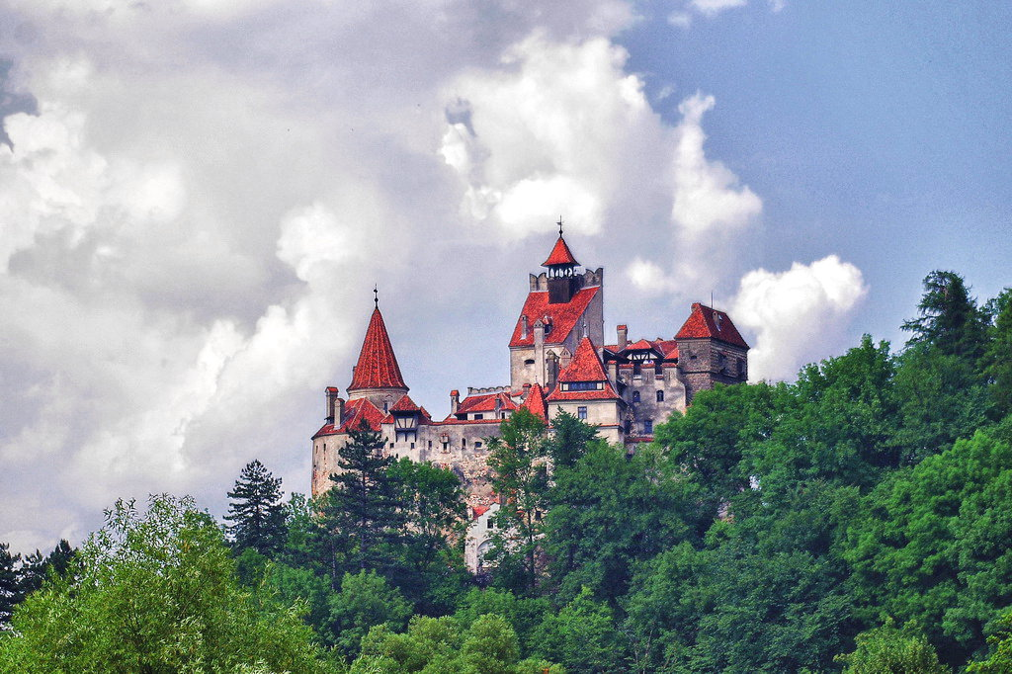
The connection of the name "Dracula" with vampirism was made by Bram Stoker around the 1890s. Since then, "Count Dracula" has been a recurring character in vampire mythology and media.
Bran Castle
Commonly known as "Dracula's Castle" (although it is one among several locations linked to the Dracula legend, including Poenari Castle and Hunyad Castle), it is marketed for resale in 2014 as the home of the titular character in Bram Stoker's Dracula.

