Slide 1
Costa Rica
Costa Rica

Slide 2
The capital city is San Jose.
There are over 121 volcanoes in Costa Rica and seven of them are active.

Slide 3
The population of Costa Rica is 4.13 million.
The climate is usually tropical but through the mountain region the weather is a bit milder.

Slide 4
The total area of Costa Rica is 51,100 square km
Fun Fact!
A female is called tica and a male is called
a tico

Slide 5
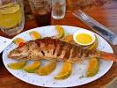
Food

Slide 6
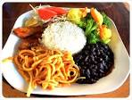
The traditional food for breakfast is Gallo Pinto
The lunch is Casados
There is no traditional dinner but the drinks are coffee or fresh fruit juice

Slide 7
Wildlife

Slide 8
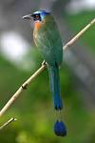
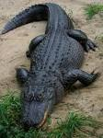
This is a motmot.
This is an ocelot.
This is an alligator.

Slide 10
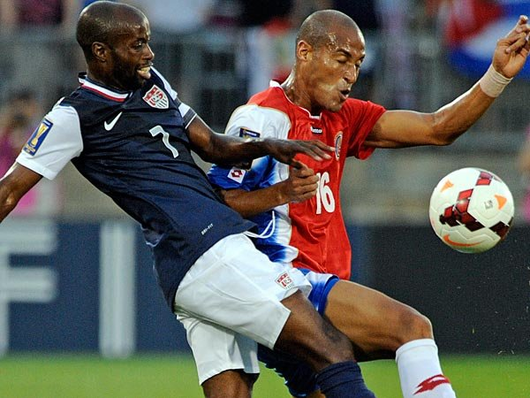
Sports!

Slide 11
The Captain of the football team is called Bryan Ruiz.

Slide 12
Traditional Sports!
Surfing
Windsurfing
Fishing
Golf
Whitewater Rafting
Diving
Birdwatching
Horse Riding
Mountain Biking
Hot Air Ballooning

Slide 13
Thank you for watching we hope you enjoyed it!
By Joanna, Angus, Amelie, Tegan, Ellis and Xander

