Slide 1
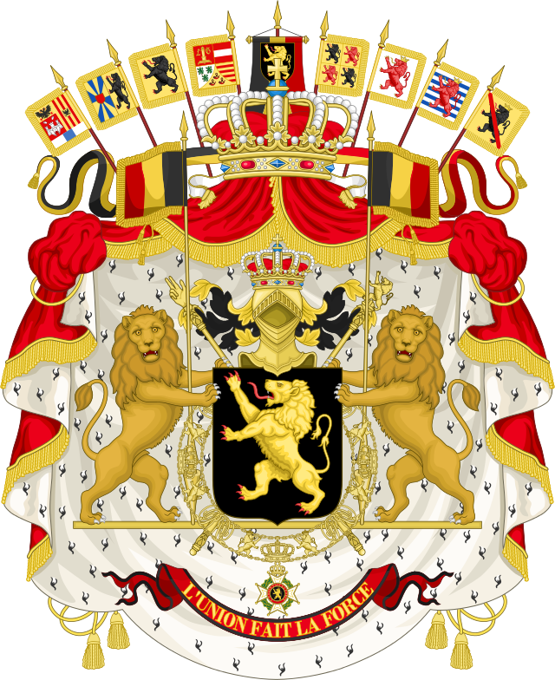
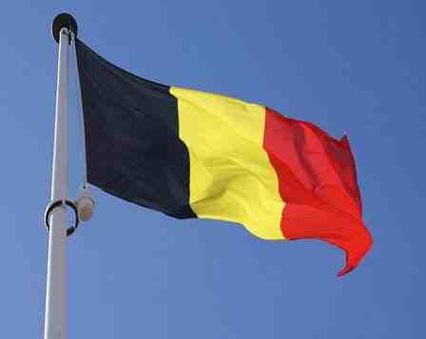
Space Ted’s Adventures around Europe World Cup research Belgium

Slide 2
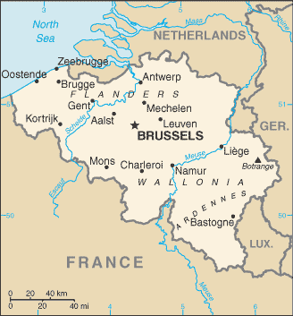
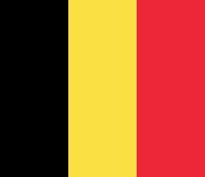
Belgium is a country located in Western Europe. The capital city is Brussels, which is home to, among others, the European Union and NATO. The extent of the country from the south-east to north-west is 280 km, and from north-east to south-west 222 km. The largest city in Belgium is Brussels, Antwerp, Ghent, Charleroi and Liege.
Where is Belgium?

Slide 3
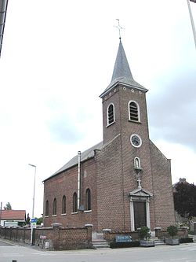
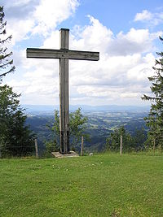
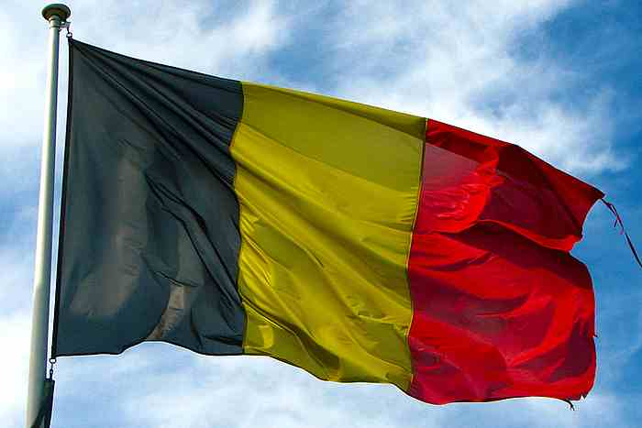
Religion in Belgium
Belgium is a trilingual country. In the 19th century one of the incentives for the creation of this state was Catholicism, as for the inhabitants of Flanders was unacceptable anti-Catholic Calvinist Netherlands. Anticlerical movement initially developed poorly there, then began to increase on the French model.

Slide 4
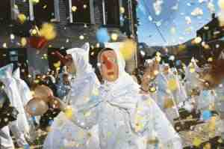
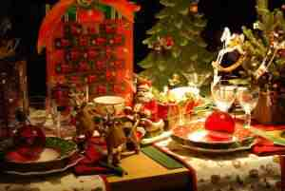
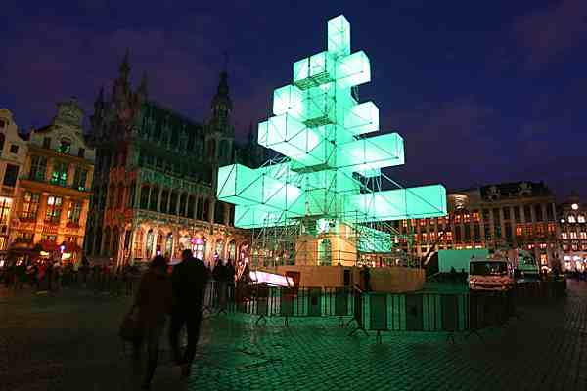
Holidays in Belgium
Belgians each year celebrate twelve public holidays. Two of them always fall on a Sunday, and if any other falls on a Sunday, the Monday is a day off from work.

Slide 5
Popular Holidays in Belgium
Christmas
Festive atmosphere prevails from November, when the market puts a crib and high Christmas tree. Belgians on the Eve serve turkey with cranberries, venison, oysters, pate and cream cakes called firelog.
Festival of Flanders
From April until the autumn in all cities of Dutch-speaking Flanders Festival lasts during which organizes performances of medieval music and classical music concerts. On the second Saturday and Sunday of June in Turnai takes place two days of great holiday - Day Four procession, during which the streets of the city are moving flowered platform, extending the host of knights, and 15 great figures symbolizes the historical figures associated with the region.
Easter
When it comes to Easter, the Belgians do not have too many customs associated with this holiday, and those that survived are slowly disappearing.

Slide 6
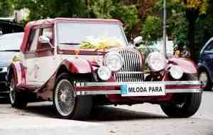
Customs in Belgium
When it comes to Easter Belgium does not have the traditional dishes that are issued on the table during the holidays. The only custom, which also began to slowly fade, is seeking children Christmas chocolate eggs, funny little things that previously hid in home gardens adults.
Besides the turkey is eaten on Christmas Eve - as in France - venison, foie gras, oysters and lobster time, and it all washed down with champagne. Mandatory is a cake with a cream called firelog, because like a piece of wood to smoke in the fireplace.
In Belgium, the ancient custom is handing over a single flower Bride mother-in and take-out. The whole is intended to symbolize the acceptance of new mothers. One of the most important and enduring traditions is the wearing of the Bride special scarves embroidered with her ​​name. After the wedding shawl is skinned and hung in a special place.

Slide 7
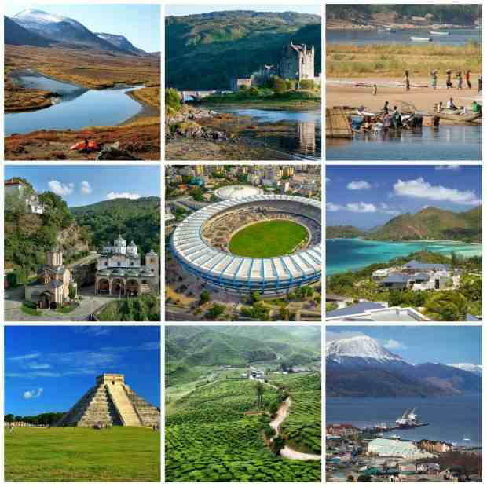

Slide 8
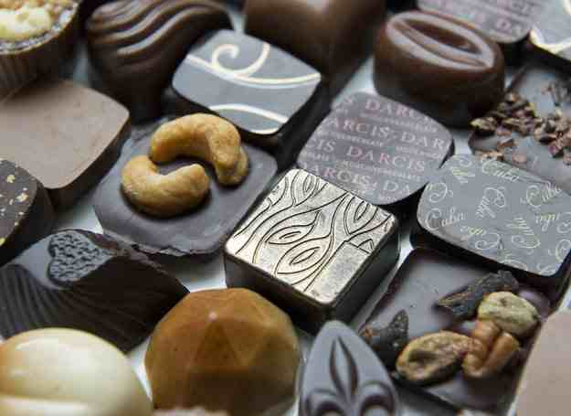
What is known for Belgium
Nevertheless, Belgian cuisine is relatively unknown and not particularly associated with elaborate dishes. However, it was the Belgians invented some really incredible popular and universal meals for example chips. Belgians also were the first to develop praline chocolate and I have to admit that this came to perfection.
Belgians also "invented" the so-called chicory. winter salad. By accident, of course. White-yellow variety of chicory appeared in the mid-nineteenth century, when John Lamers discovered with astonishment that he cultivated cereal coffee chicory shoots let go.

Slide 9
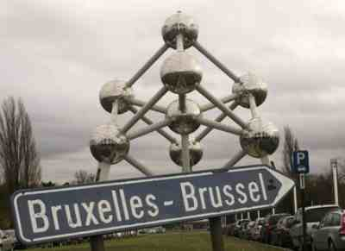
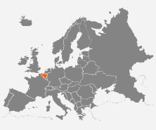
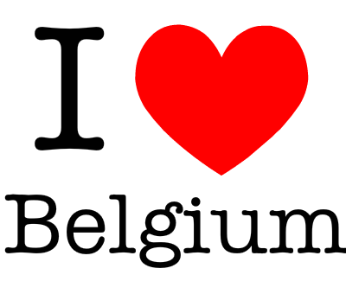
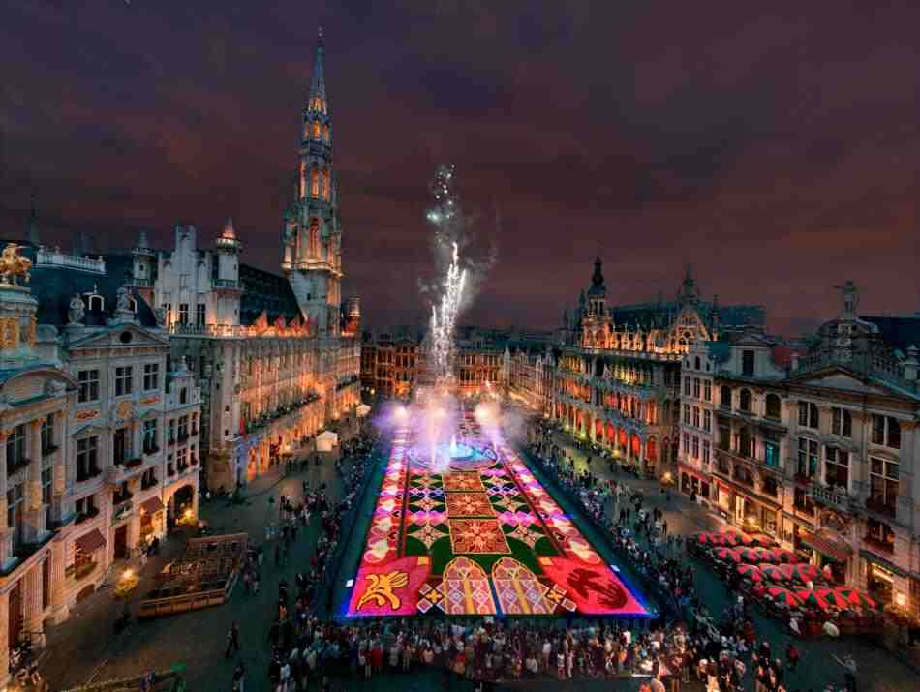

Slide 10
This project was created by Caroline
of IVa class.

