Slide 1
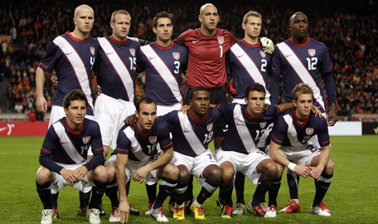
SPACE TED’S ADVENTURES AROUND EUROPE WORLD CUP RESEARCH U.S.A

Slide 2
U.S.A Map

Slide 3
Information about USA
-USA, The biggest country in the world.
-14% of the world's population (900 milion)live in the USA
-Consists of 50 states.

Slide 4
Flag the signification of the colors are as follows: White: purity, cleanliness Red: heroism, courage Blue: perseverance

Slide 5
Anthem
35 years old poet and lawyer wrote by Francis Scott Key.
It name is The Star-Spangled Banner.

Slide 6
Emblem

Slide 7
Statue of Liberty

Slide 8
History
Statue of Liberty on Liberty Island in New York, USA, have been built since 1886, which is the symbol of America is a monumental sculpture and observation tower. Is one of the world's most recognizable monuments.

Slide 9
USA Climate

Slide 10
Climate
From the arctic climate in Alaska in the western desert south America until the climatic conditions vary incredibly. In Alaska, winter temperatures dropped to -28c in Florida most of the year, in thes values ​​are at 19C. In California the weather change much: usually mild, and most 9C change. And Florida tropical Hawaiian, Alaska polar, the Mississippi River on the west semi-arid plains, southwestern "Green Basin" in the NorthWest arid, cold weather prevails.

Slide 11
Tourist Attraction
New York
Boston
Washington DC
San Francisco
Miami
Los Angeles
Chicago
Las Vegas
San Diego
Orlando

Slide 12
Niagara Falls

Slide 13
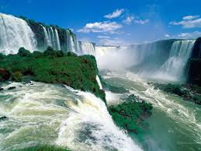
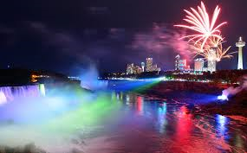
Some information about Niagara Falls
Niagara Falls in North America, east of the Canadian border with the United States, located on the Niagara River. Consists of three major waterfalls. Horseshoe is the largest of them. American Falls and Bridal Veils Fall are the other two small waterfalls.

Slide 14
The White House

Slide 15
The White House
- Being the capital of the United States federal government buildings in Washington, many of the most important. The first president of the United States, George Washington, the capital brought locate and draw plans. However, in the capital of the newly formed died in 1799 without ever sit. A year after the death of the presidential building was inaugurated. The building was painted white throughout.
-President of the United States is located in Washington official residence.

Slide 16
Hollywood

Slide 17
Hollywood
Hollywood, United States, located in the state of California, is a region of the city of Los Angeles. Is located in the northwest of the city center. Movie studios and movie stars, the house they live in this region due to condensation has become synonymous with the American movie industry.

Slide 18
Hollywood Celebrities
Anthony Hopkins
Al Pacino
Alec Baldwin
Brad Pitt
Cemeron Diaz
Jennifer Lopez
Ewan McGregor…

Slide 19
PREPARED BY:
Tuğba İpar
Şevval Özdemir
School: Zübeyde Hanım Secondary School
SAKARYA/TURKEY

