Slide 1
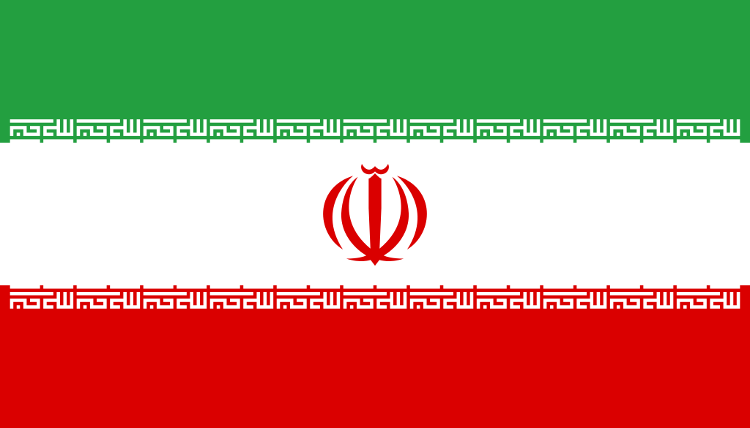
Iran Space Ted's adventures around Europe Word Cup research Iran

Slide 2
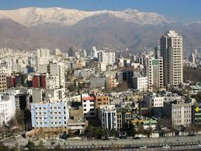
Iran-formerly known commonly in the West as Persia. Country in the Middle East, bordering the Caspian Sea, the Persian Gulf and Gulf of Oman.
Iran with its capital in Tehran.

Slide 4
On the flag of Iran, there are three colours:
- green, symbolizing religion of Islam,
- white, symbolizing peace,
- red, symbolizing bravery

Slide 6
Coat of arms of Iran

Slide 7
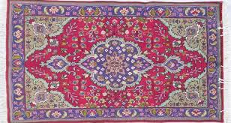
Persian carpets are sold all over the world. They are hand woven of silk or wool.

Slide 8
The most popular sport disciplines in Iran are wrestling, weightlifting and horse racing.

Slide 9
Food
Iranian cuisine varies from region to region. Each specializes in certain foods. There are also dishes and ingredients that can be considered common to the entire Iranian cuisine, such as rice, tea, raisins and various types of kebabs.
Food for Iranians is an extremely important part of life. For some quite basic, which is why many Iranians suffer from overweight.

Slide 10
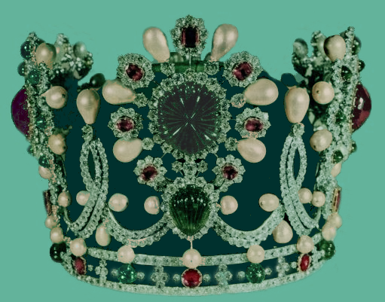
monuments of Iran
Korona Farah Pahlawi

Slide 11
Bam-city ​​located in the desert region of south-eastern Iran, in the province of Kerman. Known to the world through the ruins of the ancient city of Arg-é Bam.

Slide 12
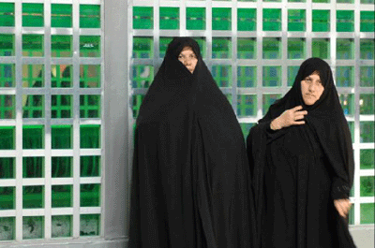
Outfit to wear
Since that time, a woman must cover her hair in public and wear a chador, usually in black. Colour czadory are worn sometimes in the provinces of the country.

Slide 13
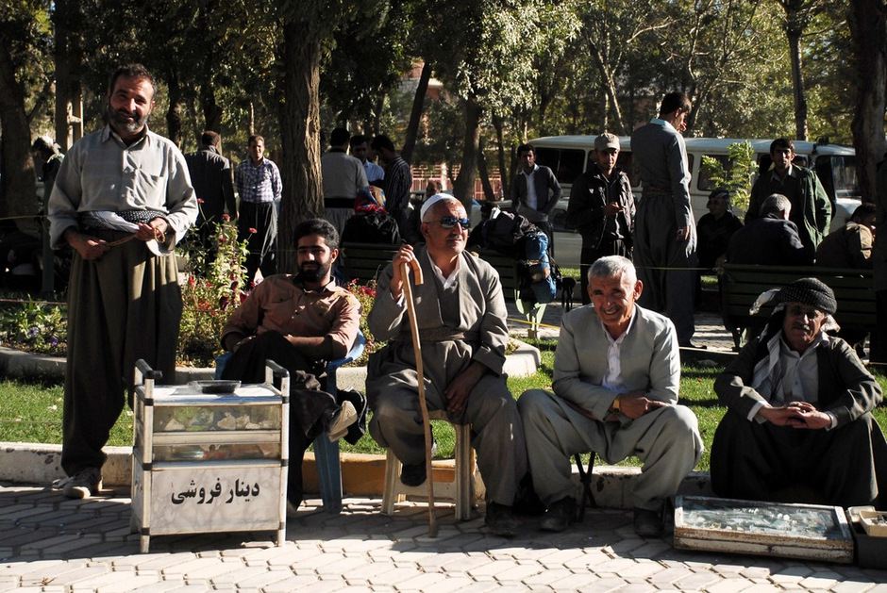
Most men wear slacks shirts and jackets. Some people, especially religious leaders wear the long dress robe and turban.

Slide 14
Family in Iranian culture
The average number of children per family is gradually falling and is now about six. The head of the house is the father, but the mother also plays an important role. Special respect turns out to older relatives, especially men.

Slide 15
languages
The most widely spoken language in Iran is Persian (58%). Other languages ​​spoken in the country belong to the subfamily mainly Turkish (26%), Kurdish (9%).

Slide 16
Religion
Most residents of Iran (98%) are Muslims, 90% Shi'ites, Sunnis 8%. The remaining 2% belong to religious minorities such as the Baha'i, Mandaizm, Sikhism, Jazydyzm, Zoroastrianism, Judaism and Christianity

Slide 17
Author:
Rozalia Golańska- class IVa

