Slide 1
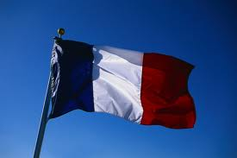
FRANCE
COMENIUS10.EU

Slide 2
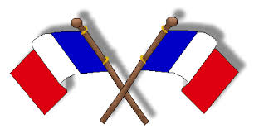
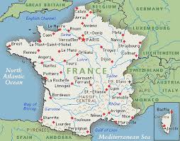
FRANCE
France officially the French Republic is a country in Western Europe. Its capital city is Paris. It is a member of the European Union. It is known for its culture, is the second largest country in Europe, with the fifth largest population in Europe. Catholicism has been religion in France for more than a millennium.
The total population of France is approaching 67 million

Slide 3
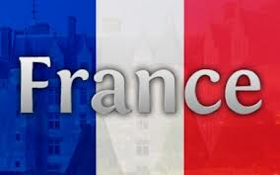
THE NATIONAL FLAG
The national flag of France is a tricolour featuring three vertical bands coloured blue (hoist side), white, and red. It is known to English speakers as the French Tricolour or simply the Tricolour.

Slide 4
THE LANGUAGES
The languages of France include the French language and some regional
languages. The French language is the only official language of France according to the second article of the French Constitution, and is by far the most widely spoken.French citizens enjoy a high standard of living, with the country performing well in international rankings of education , health care, life expectancy, civil liberties, and human development. The French educational system is highly centralised. It is divided into three different stages: primary education, or enseignement primaire , corresponding to grade school in the United States; secondary education, or collège and lycée, corresponding to middle and high school in the United States; and higher education

Slide 5
SIGHTS
France remains the world's number one tourist destination, and it's not hard to understand why. France has it all - or more or less. It has tourist sights for all tastes. It has some of the greates beaches in Europe, as well as the highest mountains and the finest historic monuments, such as the Louvre , the Eiffel Tower , Disneyland , La defence , Mont Saint Michel , Pantheon , Versailles and Notre Dame de Paris. France is divided into 22 regions that are further subdivided department’s, the most idyllic countryside, the most magnificent castles, the finest rivers such as and plenty more, not to mention some of the best restaurants and the finest wines and more hotels than any other country in Europe.

Slide 6
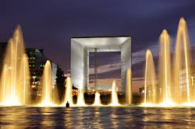
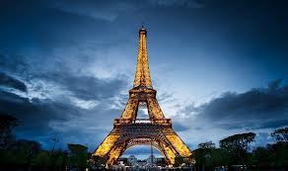
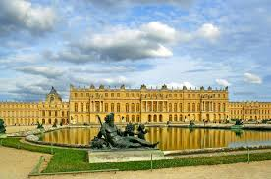
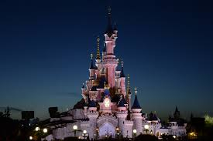
Eiffel Tower
La defence
Disneyland
Versailles

Slide 7
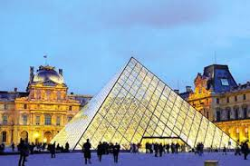
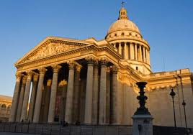
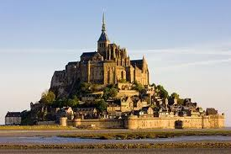
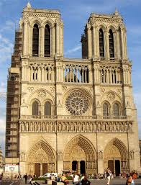
Pantheon
Pantheon
Louvre
Mont Saint Michel
NOTRE DAME DE PARIS
Mont Saint Michel

Slide 8
Many French artists have been among the most renowned of their time, and France is still recognized in the world for its rich cultural tradition.
If you’re curious about French food habits you have to learn that French way of eating is completely different than our. The culture of France and of the French people has been shaped by geography, by profound historical events, and by foreign and internal forces and groups. It’s all about the French attitude about everyday life. So many people still stand in line to the local boulangerie, waiting on their turn to buy fresh bread every morning and in the afternoons they are there again, either to pick up more bread.

Slide 9
CLIMATE
The north and northwest have a temperate climate, while a combination of maritime influences, latitude and altitude produce a varied climate in the rest of Metropolitan France.^{[64]} Most of France in the south has a Mediterranean climate that prevails. In the west, the climate is predominantly oceanic with a high level of rainfall, mild winters and warm summers. Inland the climate becomes more continental with hot, stormy summers, colder winters and less rain. The climate of the Alpsand other mountainous regions is mainly alpine, with the number of days with temperatures below freezing over 150 per year and snow cover lasting for up to six months. La defence

Slide 10
Culture
France has been a center of Western cultural development for centuries. Many French artists have been among the most renowned of their time, and France is still recognized in the world for its rich cultural tradition.
The successive political regimes have always promoted artistic creation, and the creation of the Ministry of Culture in 1959 helped preserve the cultural heritage of the country and make it available to the public. The Ministry of Culture has been very active since its creation, granting subsidies to artists, promoting French culture in the world, supporting festivals and cultural events, protecting historical monuments. The French government also succeeded in maintaining a cultural exception to defend audiovisual products made in the country.

Slide 11
France receives the highest number of tourists per year, largely thanks to the numerous cultural establishments and historical buildings implanted all over the territory. It counts 1,200 museums welcoming more than 50 million people annually .The most important cultural sites are run by the government, for instance through the public agency Centre des monuments nationaux , which is responsible for approximately 85 national historical monuments.
The 43,180 buildings protected as historical monuments include mainly residences and religious buildings gardens. The UNESCO inscribed 38 sites in France on the World Heritage List.

Slide 12
Area
Includes Metropolitan France and overseas regions, but excludes overseas territories and collectivities, shown separately .
France is recognized for its culture. There are lots of gems and jewels scattered in French literature which have found their place even just in the world literature. In France they supremacy in all the branches of art is why culture of France is really highly revered all over Europe and also the world. The cuisine of France is really a treat for that olfactory senses.. It is extremely common an exercise to shake hands while leaving work. Both men and women hug one another as a mark of excellent acquaintance. The dining etiquette too must be properly followed to prevent any embarrassment within the public. In France they, while dining, keep their arms up for grabs. One essential point, it is best to greet a stranger with Monsieur (for male) and Madame).

Slide 13
When you’re introduced to a French person , you should say ‘good day, Sir/Madam’ ( bonjour Madame monsieur) and shake hands (a single pump is enough – neither limp nor knuckle-crushing). When saying goodbye, it’s a formal custom to shake hands again. In an office, everyone shakes hands with everyone else on arrival at work and when they depart.
It’s also customary to say good day or good evening ( bonsoir) on entering a small shop and goodbye ( au revoir Madame/monsieur) on leaving.

Slide 14
You shouldn’t serve any drinks (or expect to be served one) before all guests have arrived – even if some are an hour or more late! If you’re offered a drink, wait until your host has toasted everyone’s health ( santé) before taking a drink. If you aren’t offered (another) drink, it’s time to go home. Always go easy on the wine and other alcohol; if you drink to excess you’re unlikely to be invited back! The French say bon appétit before starting a meal and you shouldn’t start eating until your hosts do. It’s polite to eat everything that’s put on your plate. Cheese is served before dessert.
Although the French are often formal in their relationships, their dress habits, even in the office, are often extremely casual. Note, however, that the French tend to judge people by their dress, the style and quality being as important as the correctness for the occasion (people often wear ‘designer’ jeans to dinner).

Slide 15
You aren’t usually expected to dress for dinner, depending of course on the sort of circles you move in.
Always introduce yourself before asking to speak to someone on the telephone. Surprisingly it’s common to telephone at meal times, e.g. 12.00 to 14.00 and around 20.00, when you can usually be assured of finding someone at home. If you call at these times, you should apologise for disturbing the household. It isn’t always advisable to make calls after 14.00 in the provinces, when many people have a siesta.
France has famous cuisine .Caesars salad its one of them and many more .

Slide 16
