Slide 1
ENGLAND
COMENIUS10

Slide 2
England is a beautiful country. It has got population 53.01 million in 2011and area 130,395 km². The flag of England is the St George's Cross heraldic blazon Argent, a cross gules. The association of the red cross as an emblem of England can be traced back to the Middle Ages, and it was used as a component in the design of the Union Flag in 1606 however, the English flag has no official status within the United Kingdom. Since the 1990s it has been in increasingly wide use, particularly at national sporting events.

Slide 3
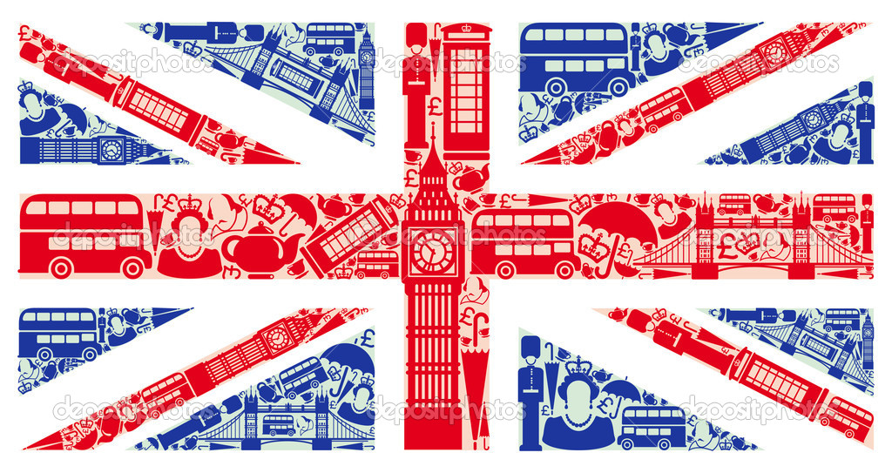
England has got a lot of sights which make England famous and many visitors visit them. Some of England’s sights are:

Slide 4
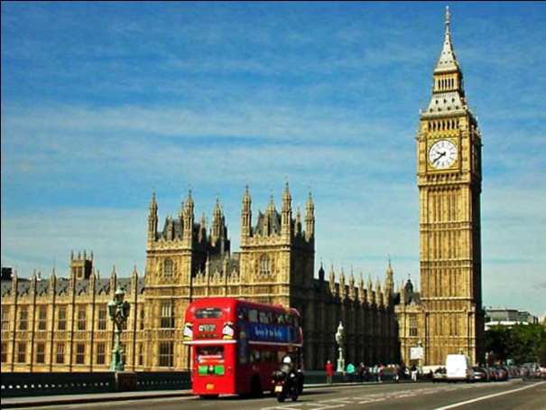
Big Ben: is the nickname for the great bell of the clock at the north end of the Palace of Westminster in London. The tower is officially known as the Elizabeth Tower to celebrate the Diamond Jubilee of Elizabeth II. The tower holds the largest four-faced chiming clock in the world and is the third-tallest free-standing clock tower. The tower was completed in 1858 and had its 150th anniversary on 31 May 2009, during which celebratory events took place. The tower has become one of the most prominent symbols of the United Kingdom and is often in the establishing shot of films set in London.

Slide 5
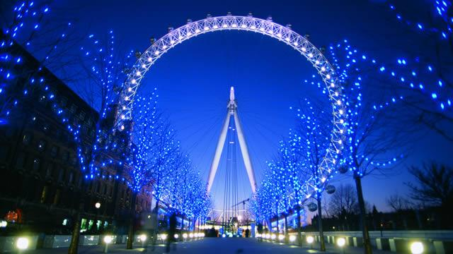
London eye: is a big wheel in London on the south bang of the River Thames. Also known as the Millennium Wheel, its official name was originally the British Airways London Eye, then the Merlin Entertainments London Eye, and since January 2011, the EDF Energy London Eye. The entire structure is 135 meters tall and the wheel has a diameter of 120 meters. It is currently Europe's tallest Ferris wheel, the most popular paid tourist attraction in the United Kingdom with over 3.5 million visitors annually, and has made many appearances in popular culture.

Slide 6
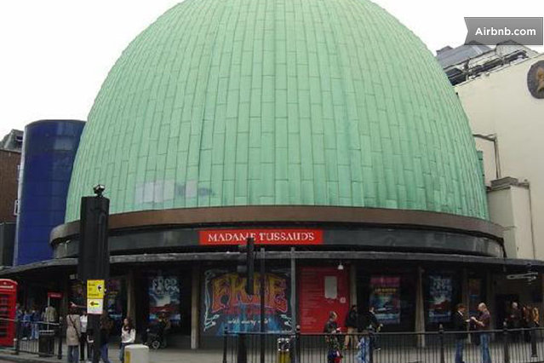
Madame Tussauds is a wax museum in London. It was founded by wax sculptor Marie Tussaud and was formerly known as "Madame Tussaud's"; the apostrophe is no longer used. Madame Tussauds is a major tourist attraction in London, displaying waxworks of historical and royal figures, film stars, sports stars and infamous murderers. Madame Tussauds is owned and operated by Merlin Entertainments.

Slide 7
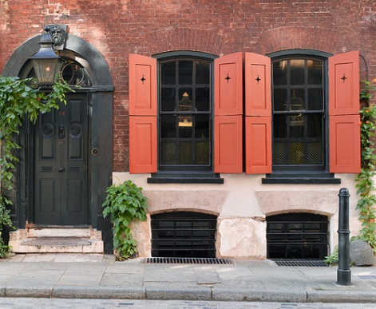
Dennis Severs’ House in London. If you visit it you feel like invading a private home, with a visit to Dennis Severs' House. It is designed as a living museum where visitors feel like... waiting owners. Each of the 10 rooms of this old house, which built in 1724, it was representing how inhabited by the owners, in different seasons of the 18th, 19th and early 20th century. You will see lit candles and unfinished meals and even hear voices!

Slide 8
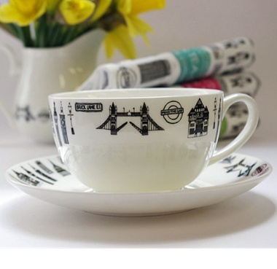
Habits and Customs:
Generally, people do not talk about their income and are probably not interested in yours. If you are travelling on the London Underground, it isn't usually customary to talk loudly or hold large conversations. If you are asked by a tour guide to be quiet when entering a building, it is best to observe this.
People in England used to drink tea in the afternoon. Day of Confession Shrove Tuesday or Pancake Day Shrive means confess Pancake. Depends Easter changes annually Pancakes associated with the day before Lent Rich in fatty foods such as milk, meat and eggs before the fasting period in England are custom football mob and pancake races that day the day was known as a half holiday in England tradition begins a landlady.

Slide 9
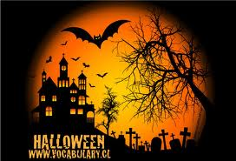
There are certain customs associated with All Saints' Day (All Hallows Day) and All Souls' Day. In the past, on All Souls' Eve families would stay up late, and little "soul cakes" were eaten. At the stroke of midnight, there was solemn silence among households, which had candles burning in every room to guide the souls back to visit their earthly homes and a glass of wine on the table to refresh them. The tradition of giving soul cakes that originated in Great Britain and Ireland was known as souling, often seen as the origin of modern trick or treating in North America, and souling continued in parts of England as late as the 1930s, with children going from door to door singing songs and saying prayers for the dead in return for cakes or money.

