Slide 1
ALGERIA
SPACE TED’S ADVENTURES AROUND EUROPE WORLD CUP RESEARCH

Slide 2
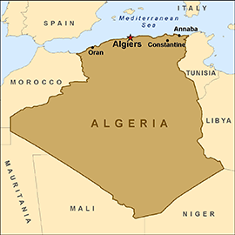
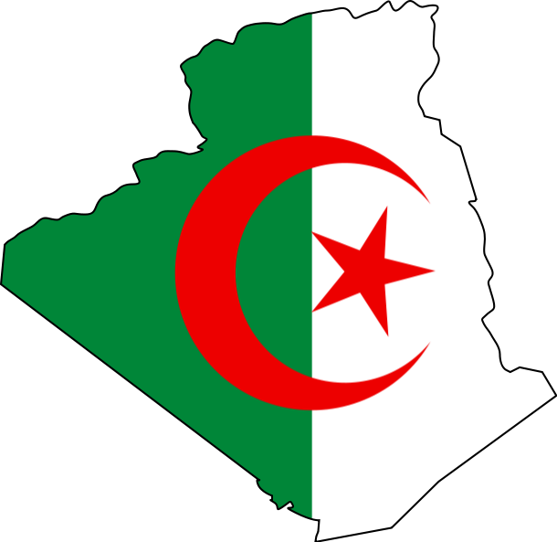
Nearly four times the size of Texas and the largest country on the continent, Algeria is bordered on the west by Morocco and Western Sahara and on the east by Tunisia and Libya. The Mediterranean Sea is to the north, and to the south are Mauritania, Mali, and Niger. The Saharan region, which is 85% of the country, is almost completely uninhabited. The highest point is Mount Tahat in the Sahara, which rises 9,850 ft (3,000 m).

Slide 3
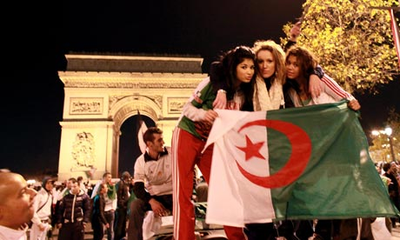
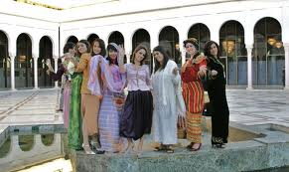
Population: 38,813,722 (July 2014 est.)
Money: Dinar
Capital City:Algiers
Religion : Muslim
Nationality: Algerian

Slide 4
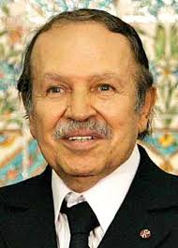
Prıme mınıster: Abdülaziz Buteflika

Slide 5
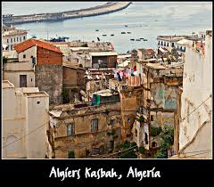
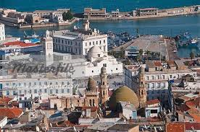
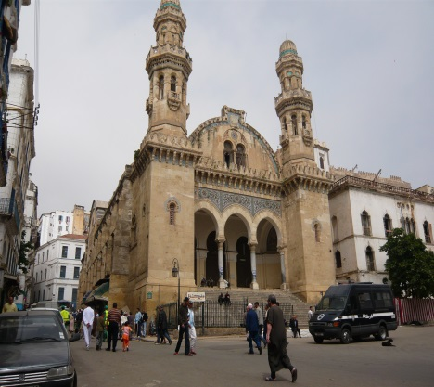
Algeria has a number of UNESCO World Heritage Sites
Touristical Attractions in Algeria
Kasbah of Algiers World Heritage

Slide 6
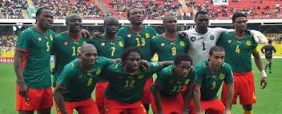

Slide 7
Gökçe Yağmur KARTAL Zubeyde Hanim Ortaokulu Sakarya/Türkiye
Prepared by

