Slide 1
WE ARE GOING TO AUSTRALIA WHERE WE’LL MEET ITS NATIONAL FOOTBALL TEAM, TOGETHER WITH TEDDY
THE FIFTH GRADERS OF THE ANAGNI “DE MAGISTRIS” AND “OSTERIA DELLA FONTANA” SCHOOLS

Slide 2
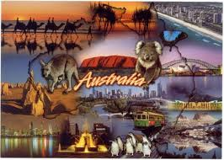
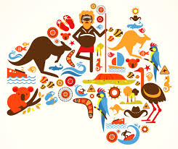
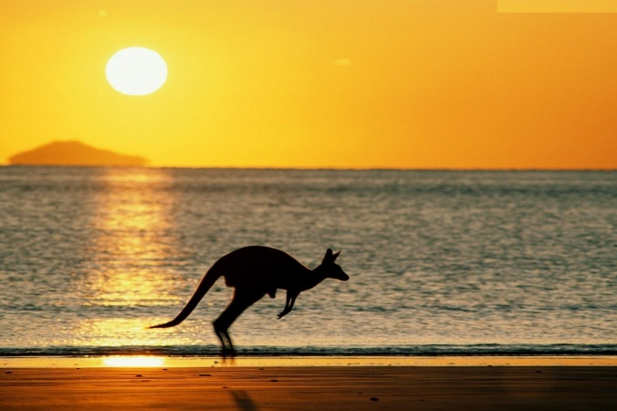
WELCOME TO AUSTRALIA

Slide 3
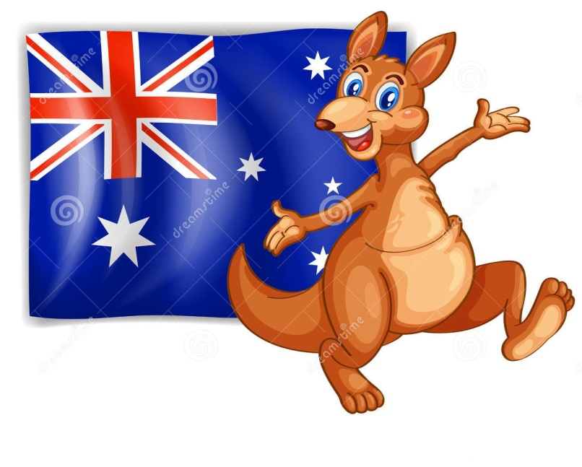
AUSTRALIA
The name Australia is derived from the Latin australis, meaning "southern".
The capital of australia is canberra.

Slide 4
AUSTRALIA ON THE MAP
Australia is an island. It’s between the Pacific Ocean and the Indian ocean. It’s the sixth largest country in the world. Australia is the only country that is also a continent.
Australia is the smallest continent in the world!

Slide 5
STATES AND TERRITORIES
Australia has six states: New South Wales (NSW), Queensland (QLD), South Australia (SA), Tasmania (TAS), Victoria (VIC) and Western Australia (WA)—and two major mainland territories—the Australian Capital Territory (ACT) and the Northern Territory (NT).

Slide 6
THE AUSTRALIAN FLAG
The Australian flag is red, white and blue. On the flag you can see a small “union Jack” and six stars. Five of the stars are small . They represent the constellation of the southern cross. The big star represents australia.

Slide 7
THE AUSTRALIAN COAT OF ARMS
The NATIONAL COAT OF ARMs CONSISTS OF A SHIELD DIVIDED INTO SIX SECTIONS. You can see an emu on the coat of arms. It is a big australian bird. It can’t fly. The emu and the kangaroo are off branches of the golden wattle. The wattle is australia’s floral emblem.

Slide 8
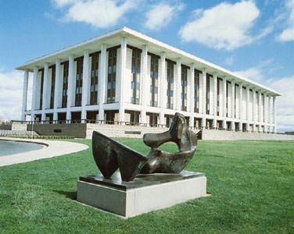
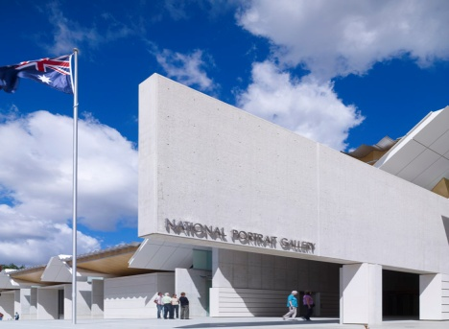
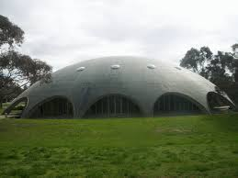
CANBERRA
This IS The house of Parliament in canberra.
Canberra is an aboriginal word, Which means “meeting place”.
You can also see the national library, the national gallery and the academy of science there.

Slide 9
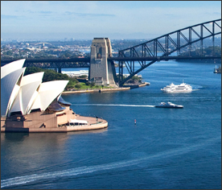
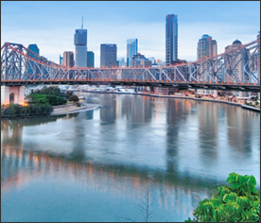
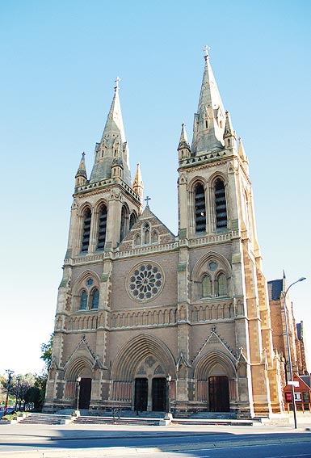
SIDNEY, BRISBANE, ADELAIDE
New South Wales, of which Sydney is the capital, was the site of Captain James Cook’s original landing in Australia, and the place where the first European settlement was established in 1788. Australia’s biggest city, Sydney has approximately 4.4 million people and is built around one of the world’s most spectacular natural harbours. In Sydney there are: Opera House, Harbour Bridge, the historic Rocks area, and excellent beaches and national parks.
brisbane IS A BIG CITY AND A SEAPORT IN EASTERN AUSTRALIAN. BRISBANE RIVER FLOWS THROUGH BRISBANE. THE CITY IS SITUATED ON BOTH BANKS OF THE RIVER. IT’S AUSTRALIA’S BUSIEST RIVER PORT.
THIS IS St peter’s cathedral in adelaide. It is called the ”city of churches” because there are many churches there. There are also many nice buildings and parks.

Slide 10
WEATHER AND CLIMATE
AUSTRALIA IS USUALY WARM AND DRY. IT IS NEVER VERY COLD. IT SNOWS ONLY IN TASMANIA AND IN THE AUSTRALIAN ALPS.
SINCE AUSTRALIA IS SOUTH OF THE EQUATOR, ITS SEASONS ARE OPPOSITE TO THOSE OF ITALY.
WHEN IT IS WINTER IN ITALY,IT IS SUMMER IN AUSTRALIA.
WINTER LASTS FROM JUNE TO AUGUST AND SUMMER LASTS FROM DECEMBER TO FEBRUARY

Slide 11
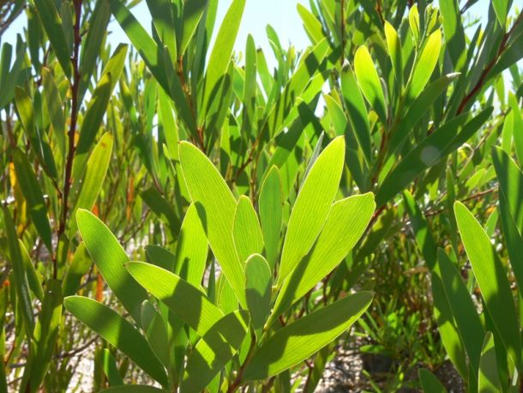
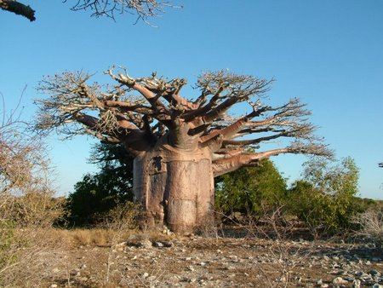
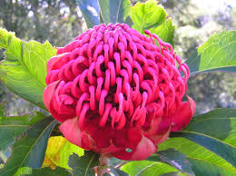
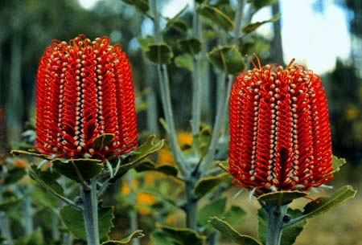
PLANTS IN AUSTRALIA
THERE ARE HUNDREDS OF DIFFERENT KINDS OF TREES IN AUSTRALIA. SOME OF THESE TREES ARE VERY UNUSUAL AND THEY ARE FOUND ONLY IN AUSTRALIA. THE MOST COMMON TREE IS THE EUCALIPTUS. IT’S ALSO CALLED THE GUM TREE. YOU CAN ALSO FIND PALM TREES, SUCH AS MACROZAMIA, GRASS TREES AND BAOBAB TREES THERE. SOME TREES HAVE FUNNY NAMES LIKE THE BOTTLETREE AND THE BEEFWOOD. IN AUSTRALIA THERE ARE THOUSANDS OF WILDFLOWERS. THE GOLDEN WATTLE OR ACACIA IS AUSTRALIA’S NATIONAL FLOWER. THERE ARE ALSO FOUR HUNDRED AND SEVENTY VARIETIES OF ORCHIDS. SOME FLOWERS HAVE STRANGE NAMES LIKE THE WARATAH AND THE BANKSIA.

Slide 12
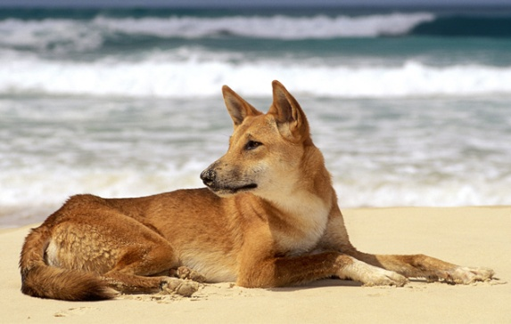
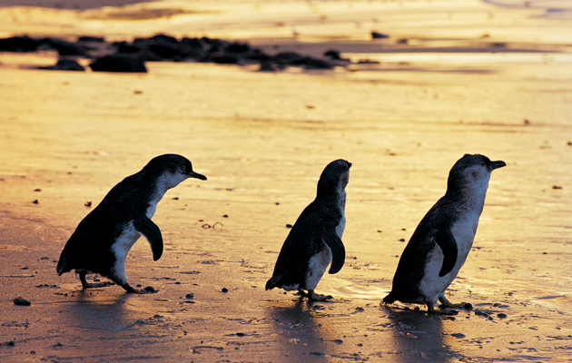
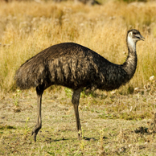
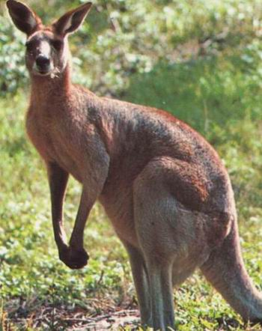
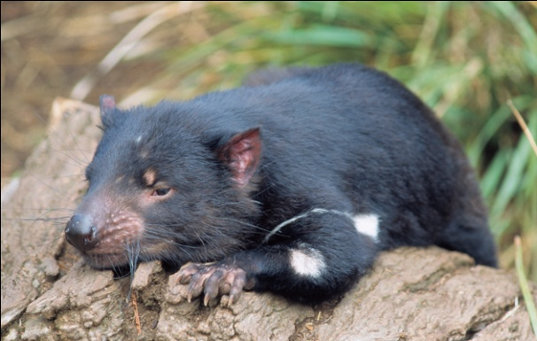
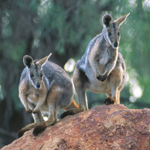
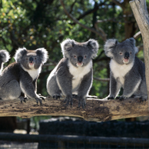
AUSTRALIA’ S ANIMAL PICTURES
The Australian Dingo
Fairy Penguins
The Australian Emu
The WallabIES
The KANGAROO
The KoalaS
The Tasmanian Devil
Australia teems with native animals. THERE ARE more mammals than anywhere else on earth and plenty of marsupials, from The TASMANIAN DEVIL TO KOALAS, WALLABIES and THE KANGAROOS. 350 species of unique birds, including the EMU, Live in Australia.

Slide 13
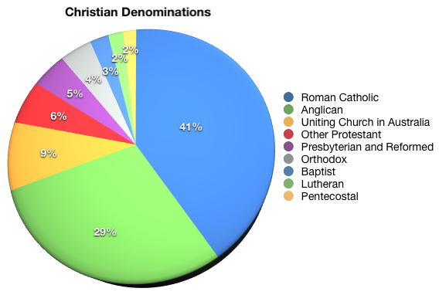
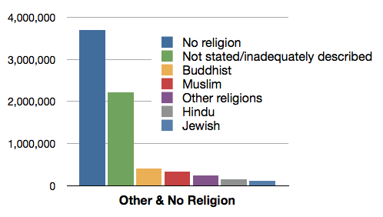
THE RELIGION
Here are some interesting religion statistics. According to the ABS 2006 census (the most recent):
About 13 million or 64% of Australians called themselves “Christian.” However, only about 7.5% attended any church services weekly (NCLS Research)
The main denominations continue to decline slowly, while 19% of Australians claimed “no religion.” Another two million did not state or adequately describe their religion.
Buddhism, Islam, Hinduism and other religions are still minorities but have also grown, due to increased immigration from the Asian region.
r

Slide 14
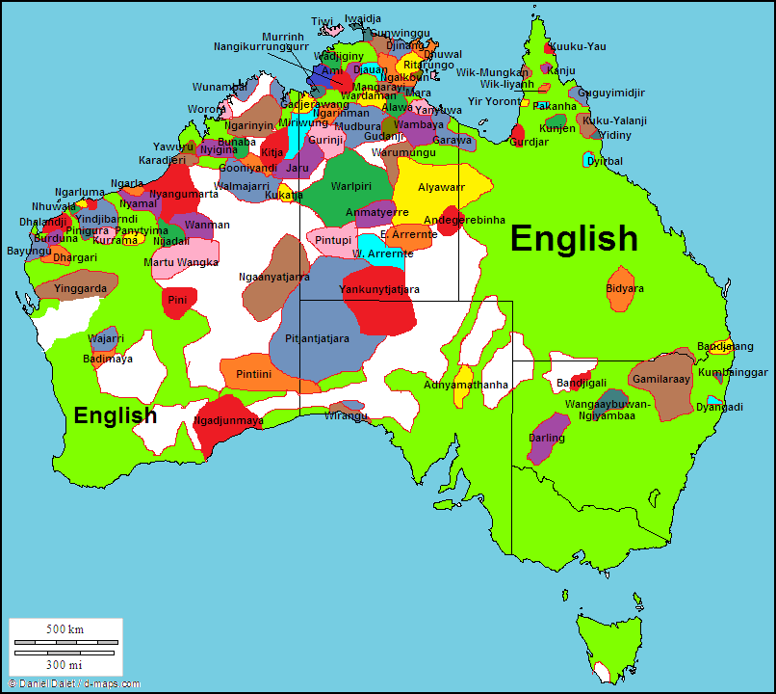
LANGUAGES OF AUSTRALIA
The English is the dominant language in Australia, many people speak a language other than English within their families and communities.
The following data is derived from the 2011 Census:
Collectively, Australians speak over 200 languages. Of these, about 50 are Australian Indigenous languages. About 18% of Australians speak a language other than English. Australian Indigenous languages are spoken by about 0.3% of the total population.
The most common languages other than English are: Italian, Greek, Cantonese, Arabic, Mandarin and Vietnamese. Collectively, Chinese languages (including Cantonese, Mandarin and other Chinese languages) have the greatest number of speakers after English, accounting for approximately 3% of the total population. The languages other than English spoken at home vary between the states.

Slide 15
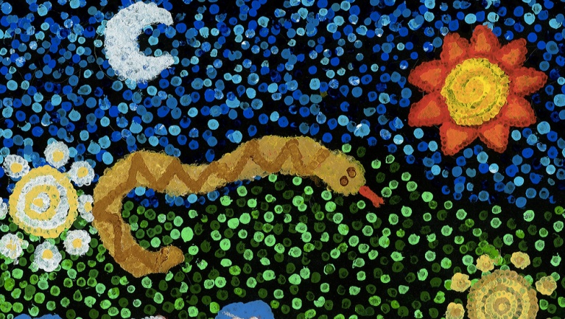
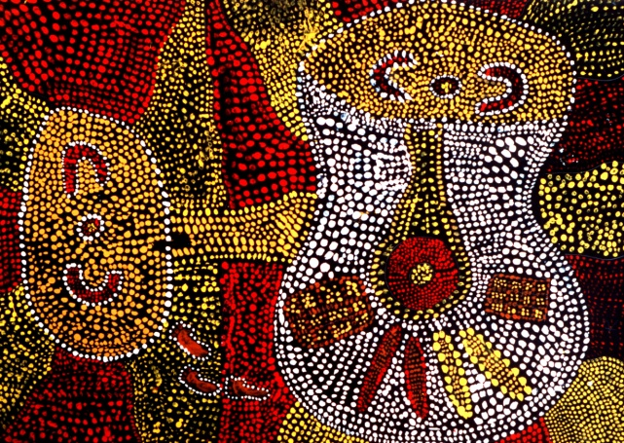
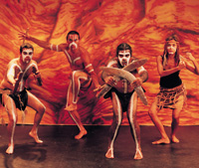
AUSTRALIAN CULTURE
Australian culture is founded on stories of battlers, bushrangers and brave soldiers. Today Australia also defines itself by its Aboriginal heritage, vibrant mix of cultures, innovative ideas and a thriving arts scene.
Aboriginal culture: a rich and timeless tradition
The Dreamtime is the sacred ‘time before time’ of the world’s creation. According to Aboriginal belief, totemic spirit ancestors emerged from the earth and descended from the sky to awaken a dark and silent world. They created the sun, moon and stars, forged mountains, rivers, trees and waterholes and changed into human and animal forms. Spirit ancestors connect this ancient past with the present and future through every aspect of Aboriginal culture. Rock art, craft and bark painting reveal Dreamtime stories, mark territory and record history, while songs tell of Dreamtime journeys, verbally mapping water sources and other essential landmarks. Their special lyrics have been passed down virtually unchanged for at least 50,000 years, and are often accompanied by clapsticks or the deep throb of the didgeridoo. Similarly, traditional dances reveal creation myths, enact the deeds of Dreamtime heroes and even recent historical events.

Slide 16
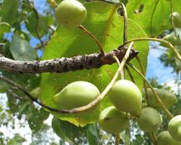
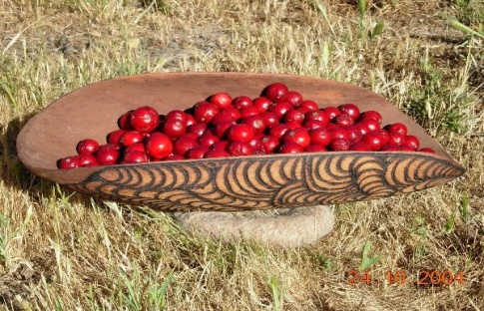
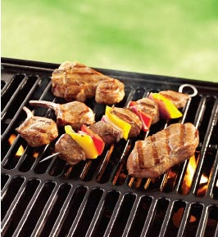
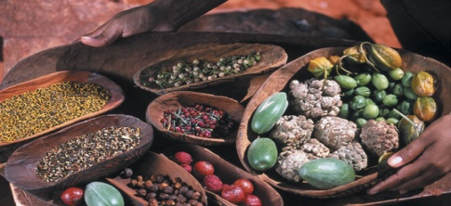
THE AUSTRALIAN FOOD
The food culture in Australia has changed over the years. The aboriginal people ate whatever the land provided, from Local Fruits such as Quandong and Kakadu plums, to meats from wild animals.
Over time, as many immigrant populations made their way to australia, the food preferences of the people changed and adapted as new cultures were introduced, each bringing its own foods, diversifying the “typical” australian cuisine.
One typically australian product is called Vegemite, which is spread on bread and sandwiches. Cooking meat outdoors on the Barbeque is also an australian tradition. One Typical drink is “billi” tea, and Australia produces many excellent wines.
Recently, there has Been a return to the local fare, with a heavy emphasis on Organic food and local products and cooking methods, collectively known as “bushfood”, or typical aboriginal dishes.

Slide 17
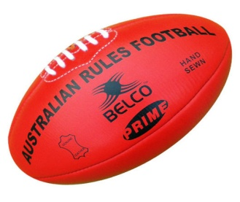
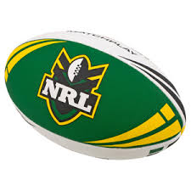
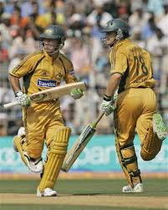
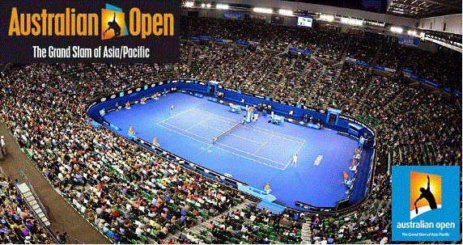
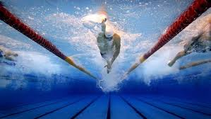
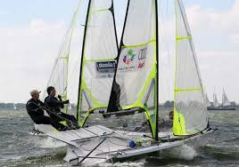
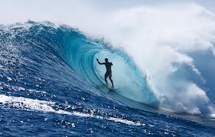
THE SPORTS
Sporting heroes: the glory of green and gold It's no secret that Australians are sports mad. With more than 120 national and thousands of local, regional and state sporting organisations,
The number one watched sport in Australia is Australian Rules Football (AFL) with its high kicks and balletic leaps, while the brute force and tackling tactics of National Rugby League (NRL) reign supreme in New South Wales and Queensland.
Australia is a nation of swimmers and Olympic medals attest to THE performance in the pool. All summer they watch the Australian cricket team in their white uniforms, and games can last up to five days! In January, they watch the tennis Australian Open, which attracts millions of people.
As Australia is a country surrounded by the ocean, there are also many water sports, such as surfing and sailing, with many international competitions held each year.

Slide 18
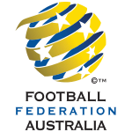
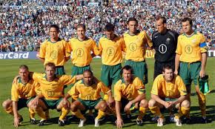
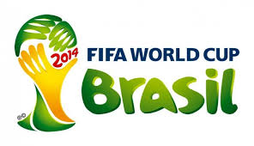
AUSTRALIA IN THE WORLD CUP
The Australia national association football team represents Australia at the FIFA World Cup Brasil .

Slide 19
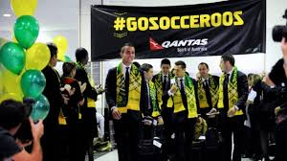
THE SOCCEROOS
Players and fans of the national team are nicknamed the Socceroos, a term derived from the fusion of soccer (football) and kangaroos (wallabies)
the Australia national association football team represents Australia in international men's association football. Officially nicknamed the Socceroos, the team is controlled by the governing body for association football in Australia, Football Federation Australia (FFA), which is currently a member of the Asian Football Confederation (AFC) and the regional ASiAN Football Federation (AFF) since leaving the Oceania Football Confederation (OFC) in 2006.

Slide 20
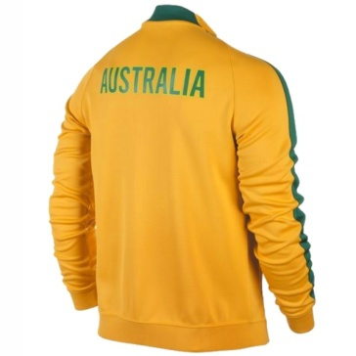
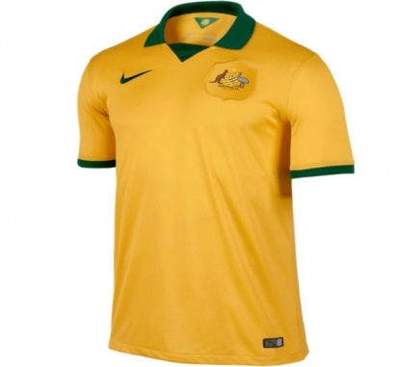
HISTORY …
The first Australia national team was constituted in 1922 for a tour of New Zealand.
The Socceroos will participate in the football World Cup for the fourth time in their history (the third TIME IN A row). The best result dates back to the 2006 World Cup in Germany: Australia managed to reach the knockout stages, where they were then eliminateD BY ITALY.
In 1974, again in Germany, and in 2010, IN South Africa, on the other hand, the path of the Australian National was out of the game. THEY DIDN’T GET PAST THE QUALIFYING ROUNDS.

Slide 21
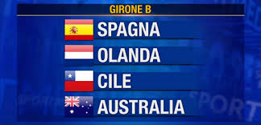
2014 WORLD CUP BRASIL
For the 2014 FIFA World Cup, Australia were drawn in Group B alongside reigning Cup holders Spain, 2010 runners-up Netherlands and Chile

Slide 22
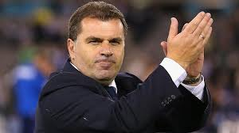
NATIONAL TEAM COACH
Ange Postecoglou is a Greek-Australian former football (soccer) player and the head Coach of the Australian national association football team.
Postecoglou was born in Athens, Greece and emigrated to Australia from his native country at the age of five, growing up in Melbourne, Victoria.
Postecoglou was appointed head coach of Australia on 23 October 2013 on a five year contract, replacing German Holger Osieck

Slide 23
GOOD LUCK AUSTRALIA…
BY THE CHILDREN OF THE ANAGNI SCHOOLS…

