Slide 1
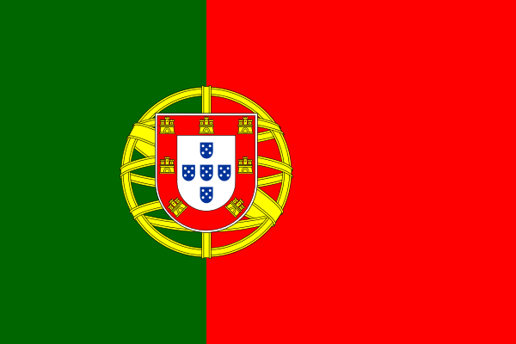
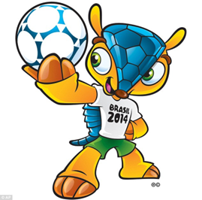
Portugal
2014 FIFA World Cup Brazil

Slide 2
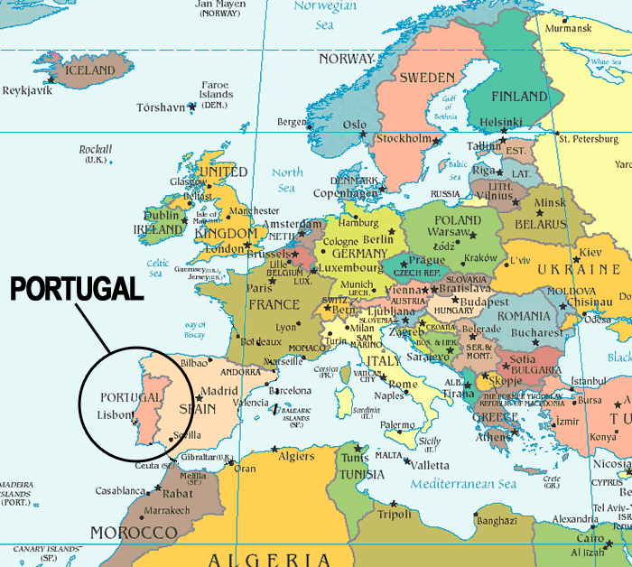
GEOGRAPHY
Portugal is situated at the south-west point of Europe and also includes the Madeira and Azores archipelagos in the Atlantic Ocean.

Slide 3
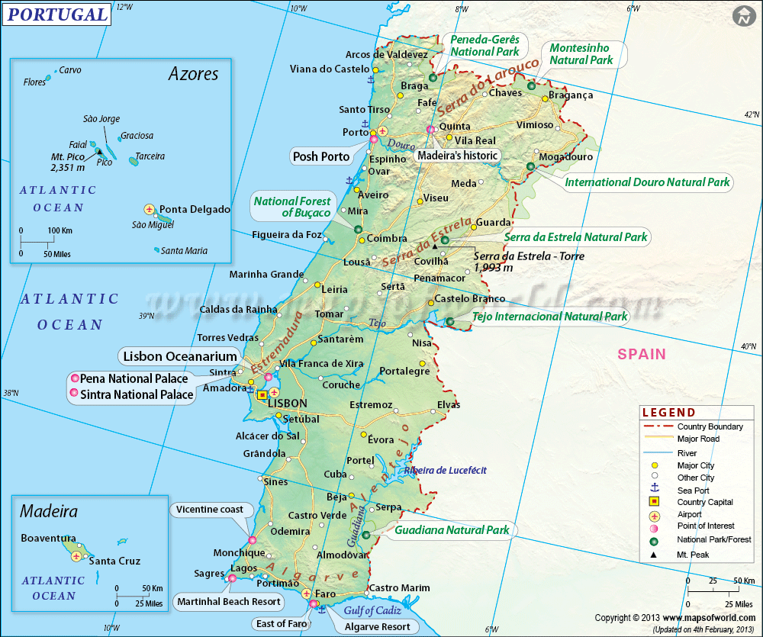
GEOGRAPHY
Total area of Portugal is 92,212 km².
It is 218 km wide and 561 km long. It has 832 km of Atlantic coast and a 1,215 km border with Spain.

Slide 4
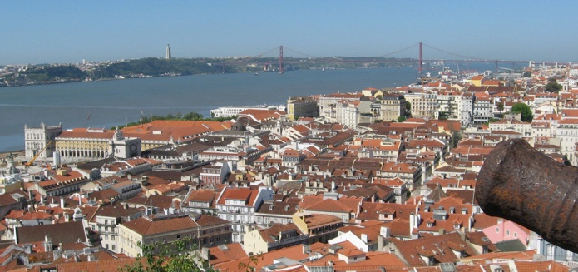
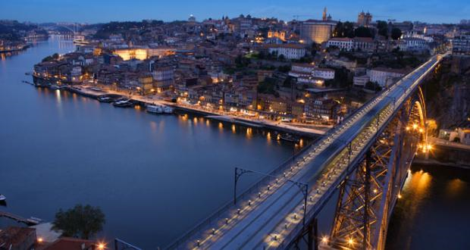
POPULATION
Portugal has a population of about 10 million.
The population density is at its greatest in Lisbon, the capital and its suburbs, where about 1.9 million people live.
The second largest city
in Portugal is Oporto in
the north.

Slide 5
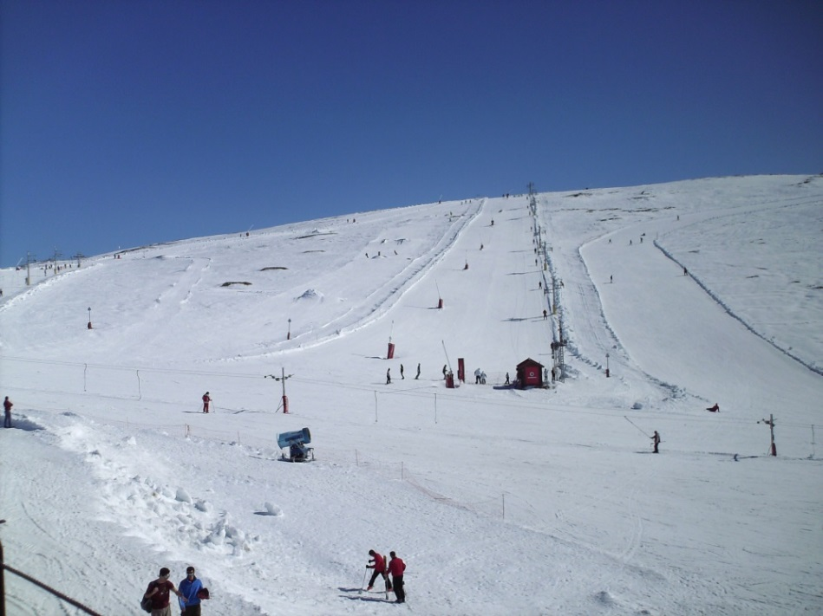
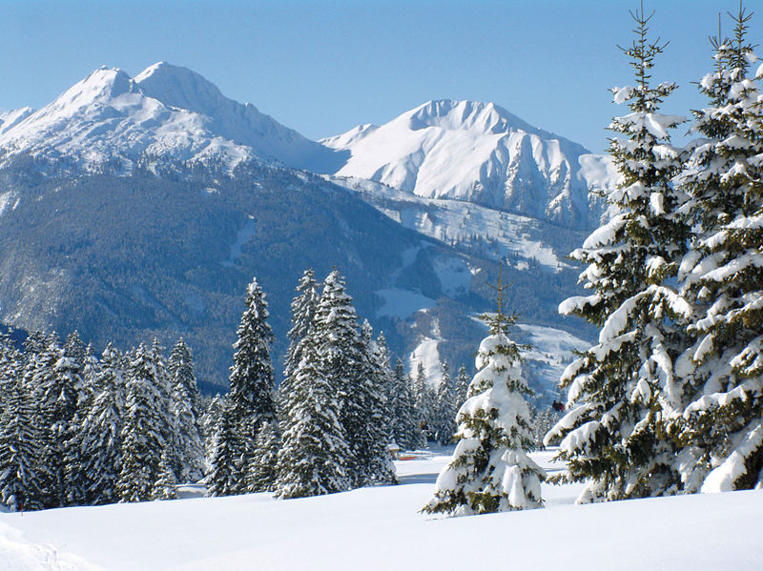
CLIMATE
In the Oporto, North area and Beiras region, particularly inland, nearer Spain, the winters are colder, although the temperatures are still mild when compared to the rest of Europe.
There is some snowfall. It
occurs most in the Serra da Estrela
mountains, where we find the
highest point in mainland Portugal
(1,991 m) and where it is
sometimes possible to ski.

Slide 6
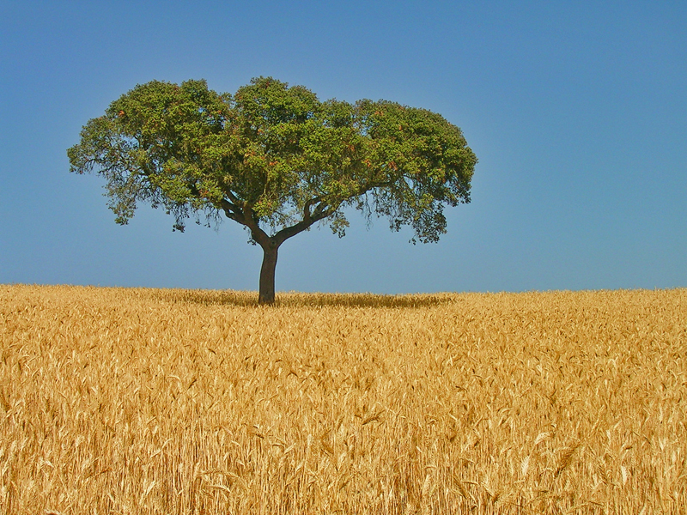
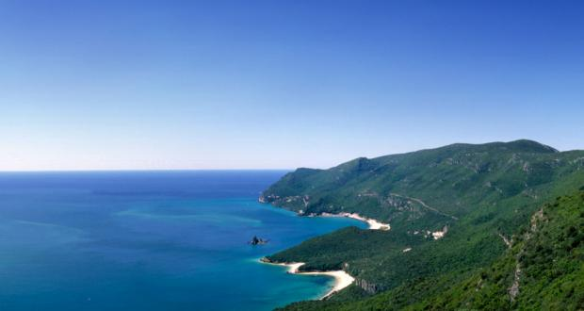
CLIMATE
The summers are hot and dry, especially in the inland areas (Trás-os-Montes in north-eastern Portugal and Alentejo).
Temperatures are slightly
lower in the coastal areas,
because of the influence of
the sea.

Slide 7
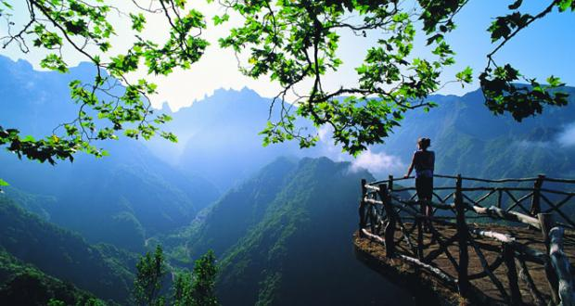
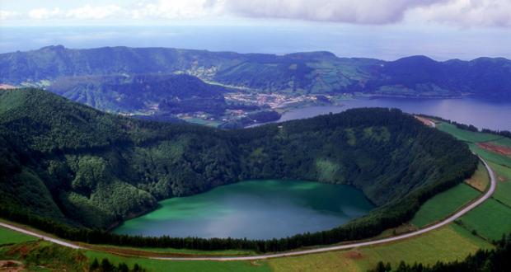
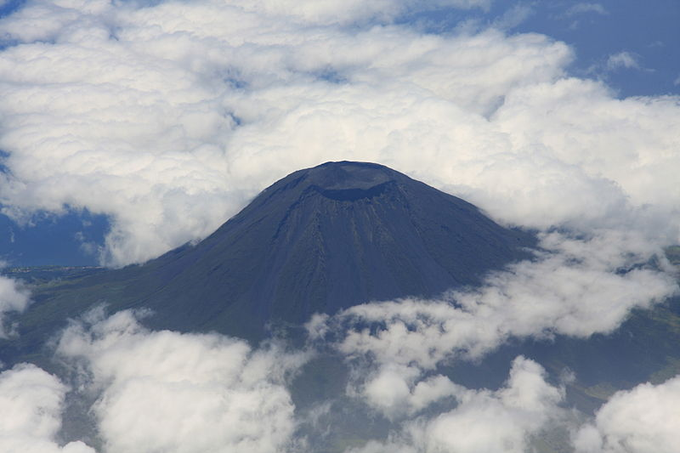
Islands - Azores and Madeira
The climate in the Azores is influenced by the islands’ latitude and by the Gulf Stream, and temperatures are mild there all year round.
The subtropical characteristics of the weather in the Madeira Archipelago can be explained by its geographical position and mountainous relief.
The climate in Madeira is exceptionally mild, with average temperatures varying between 24 ºC in summer and 19 ºC in winter.
The same factors also influence the
sea temperature, which is very pleasant
both in winter and summer and ideal for
nautical sports all year round.

Slide 8
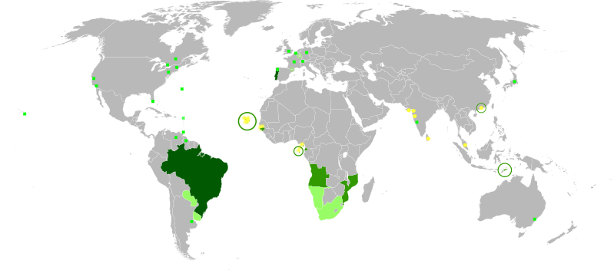
LANGUAGE
One of the Latin languages, Portuguese is the third most spoken European language in the world and the native tongue of about 250 million people.
The Portuguese-speaking countries are scattered all over the world. Portuguese is spoken in:
- Africa (Angola, Cape Verde, Guinea-Bissau, Guinea Equatorial, Mozambique and São Tomé e Príncipe);
- South America (Brazil);
- Asia (East Timor) and it is also the official language in Macao Special Administrative Region of China;
As the result of expansion during colonial times, Portuguese speakers are also found in Goa, Daman and Diu in India and in Malacca in Malaysia.

Slide 9
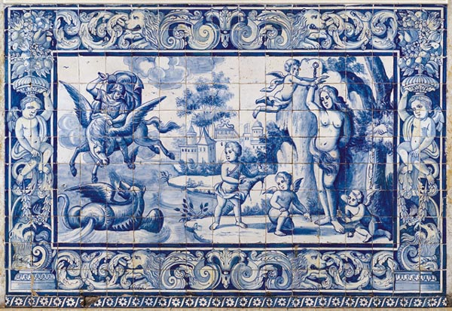
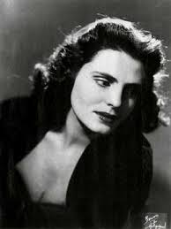
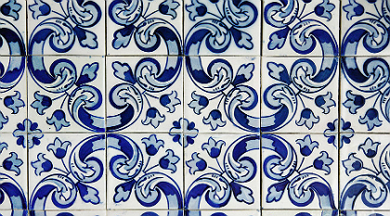
CULTURE
Music
Visual arts
Fado is a portuguese music genre usually singing by one person accompanied by one classic guitar and portuguese guitar.
Amália Rodrigues, the Portuguese singer known as Queen of Fado.
Azulejo is a form of
portuguese painted, tin-glazed,
ceramic tilework.

Slide 10
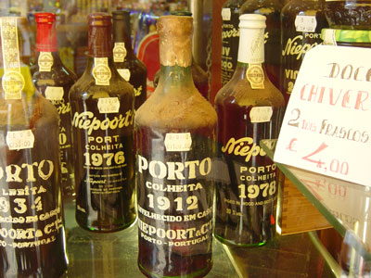
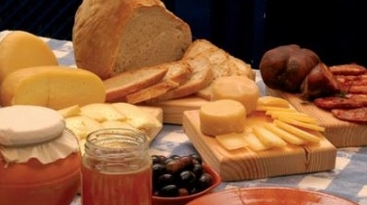
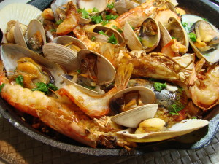
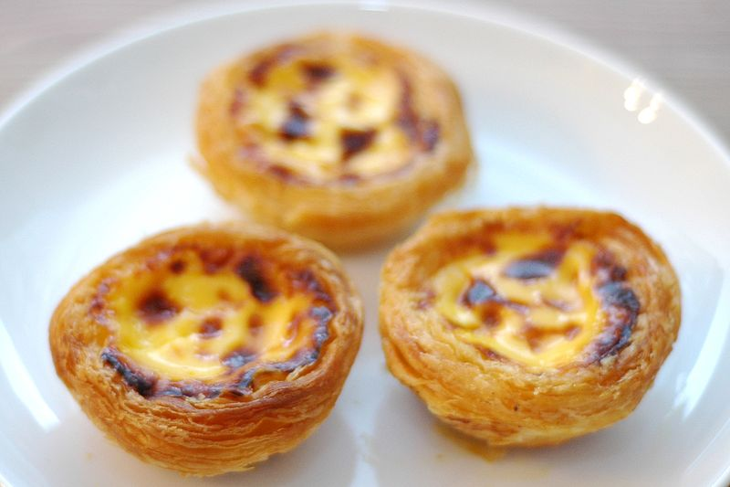
CUISINE
Cheeses, Sausages, Bread and Olives
Porto Wine
Pastel de Nata (custard tart)
Sea Food

Slide 11
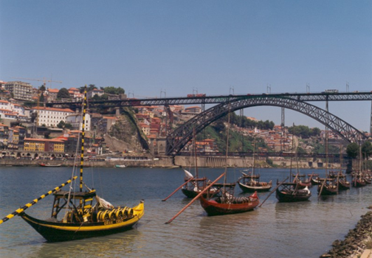
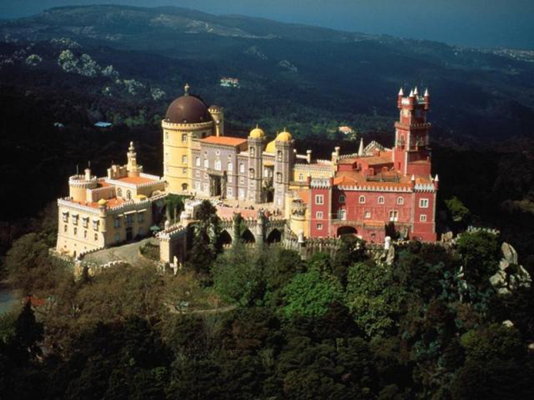
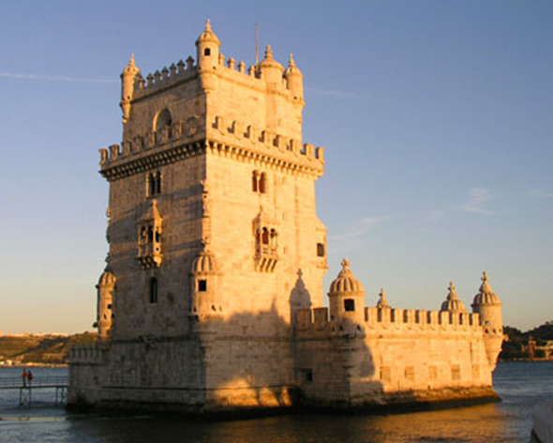
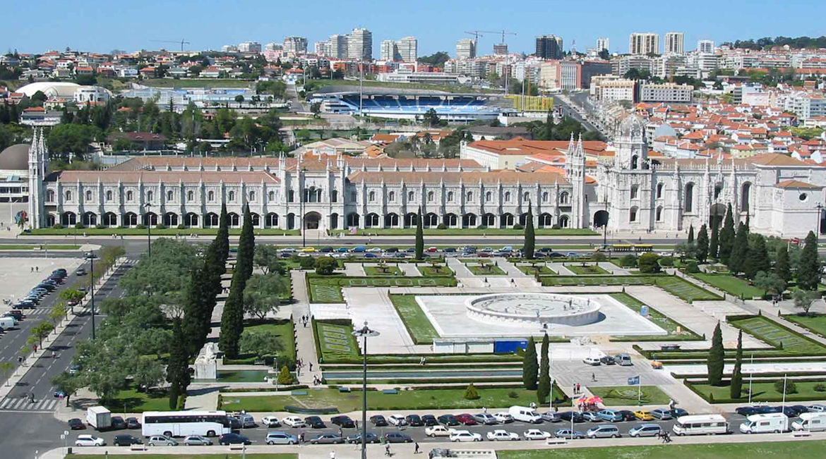
INTERESTING PLACES
Douro River (Oporto)
National Palace (Sintra)
Belém Tower and Jerónimos Monastery (Lisbon)

Slide 12
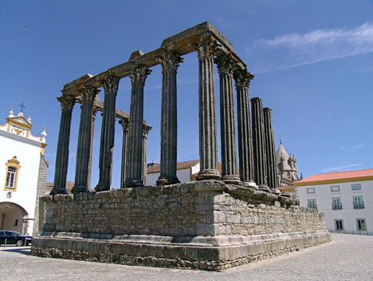
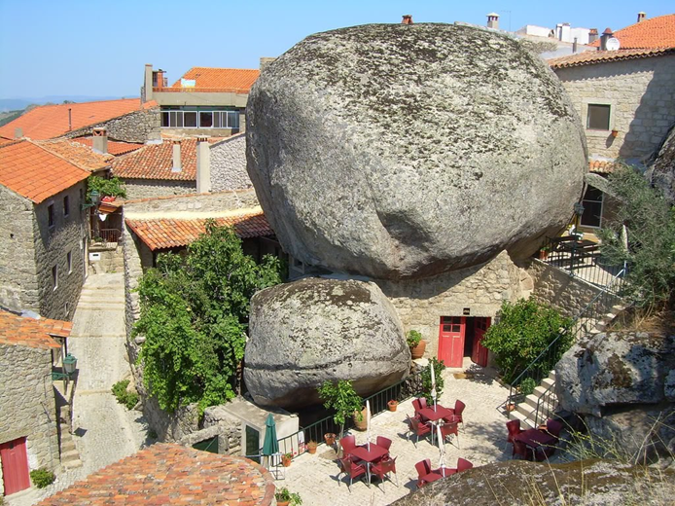
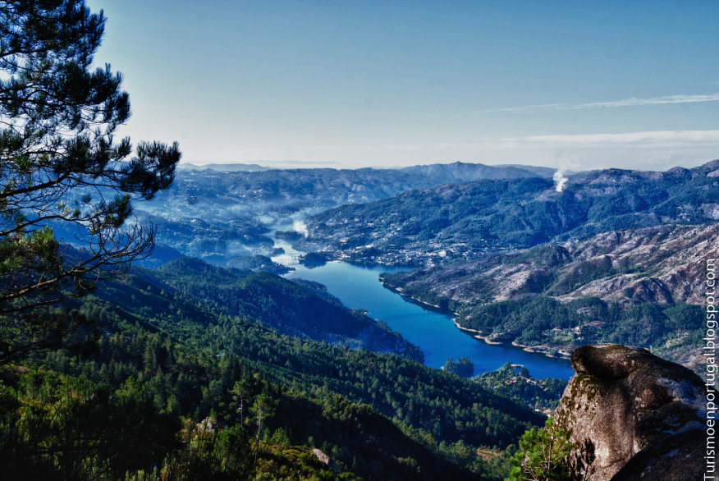
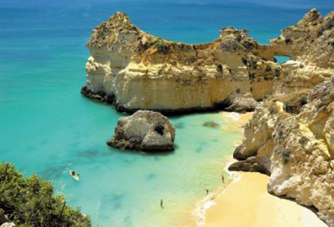
Temple of Diana (Évora)
Monsanto Village
Peneda-Gerês National Park
Beaches

Slide 13
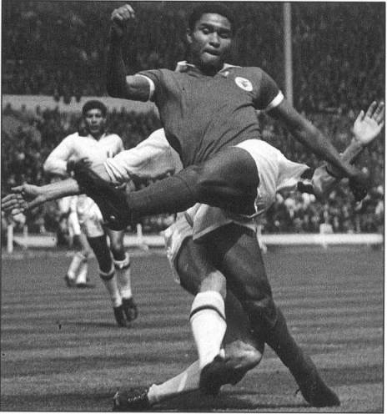
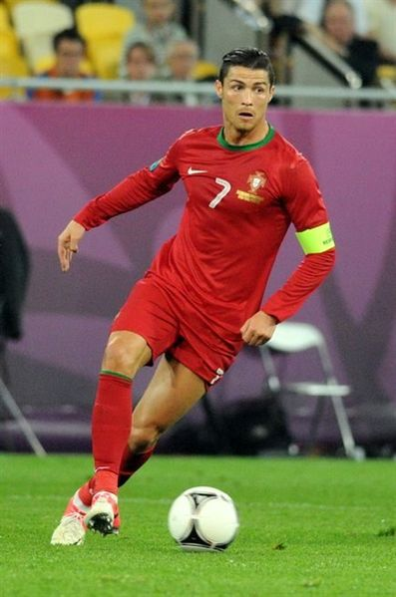
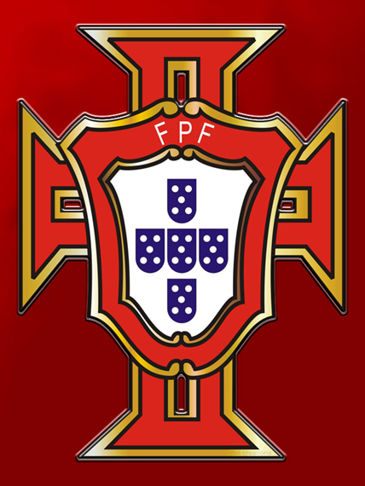
SPORT
Football is the most popular sport in Portugal.
The legendary Eusébio is still a major symbol of
Portuguese football history.
FIFA World Player of the Year winners
Luís Figo and Cristiano Ronaldo who won
the fifa "ballon d'Or" for 2013, are among the
numerous examples of other
world-class football
players born in Portugal.
Eusébio da Silva Ferreira
Cristiano Ronaldo,
captain of the Portugal national football team.

Slide 14
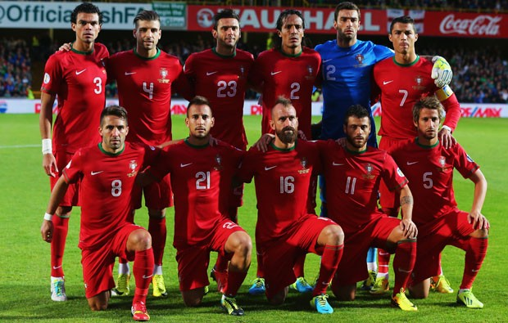
The main national team finished second in Euro 2004 (held in Portugal),
reached the third place in the 1966 FIFA World Cup, and reached the fourth
place in the 2006 FIFA World Cup, their best results in major competitions
to date.
Portugal's home stadium is the National Stadium and their head coach
is Paulo Bento.
Good luck!

