Slide 1
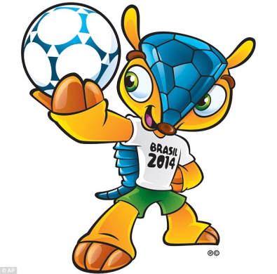
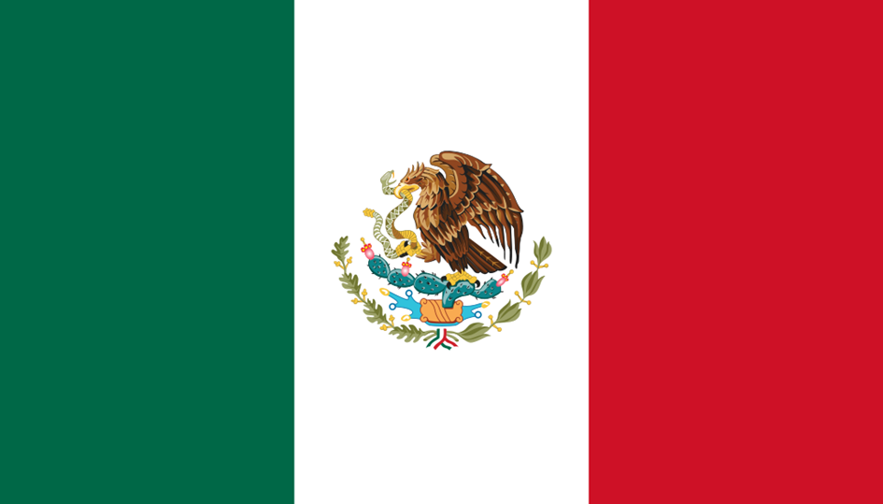
2014 FIFA World Cup Brazil
Mexico

Slide 2
Mexico officially the United Mexican States is a federal republic in North America. It is bordered on the north by the United States; on the south and west by the Pacific Ocean; on the southeast by Guatemala, Belize, and the Caribbean Sea; and on the east by the Gulf of Mexico.

Slide 3
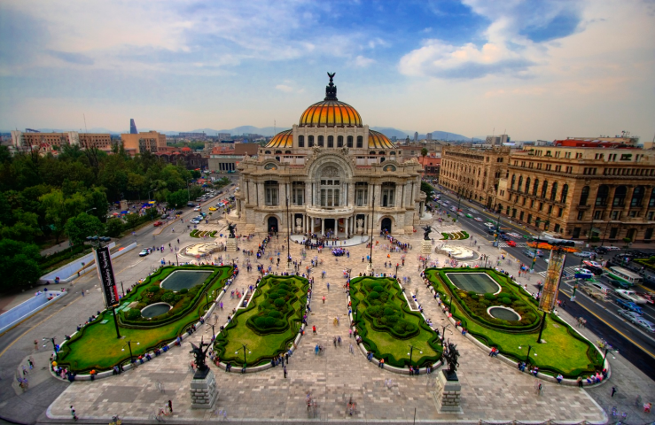
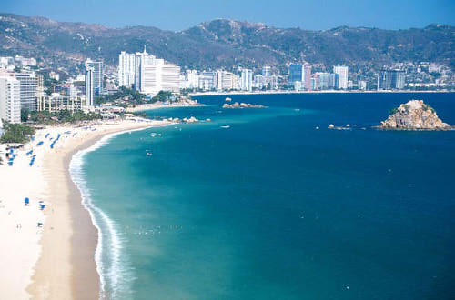
The capital and largest city is Mexico City
Population of 118,395,054 as
of 2013
Language – Mexico's official language is Spanish, and Mexico is home to the world’s largest population of Spanish speakers, but over 50 indigenous languages like Mayan or Nahuatl are spoken by more than 100,000 people.
Currency – Mexican Peso

Slide 4
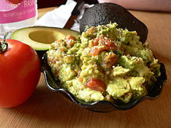
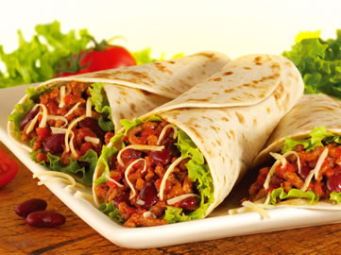
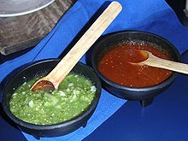
Traditional Cuisine
Burritos
Guacamole
Green and red salsa
Tequila

Slide 5
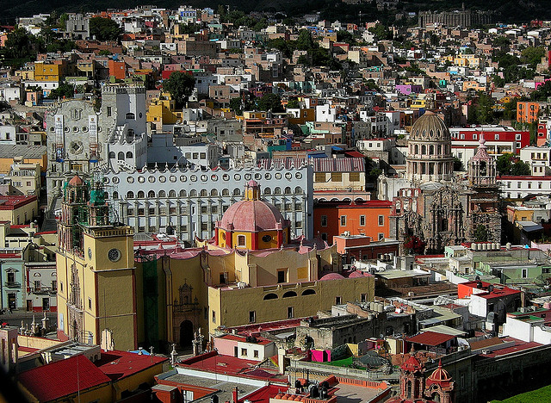
Places to visit
Chichen Itza is the largest of
the Maya cities in the Yucatan
Peninsula.
Nestled in the mountains of the
Sierra de Guanajuato lies the
beautiful colonial city of Guanajuato.
The city was founded in 1554 next
to one of the richest silver mining
areas of Mexico.

Slide 6
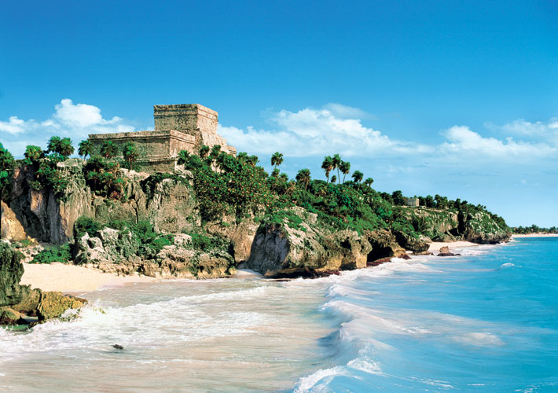
The Riviera Maya runs south
of Cancun from Puerto Morales
to just south of Tulum.
The area is famous for its
gorgeous, broad white-s and
beaches and relaxed atmosphere.
Palenque is an archaeological site
that was located on the western
edge of the Maya empire in the
present-day state of Chiapas,
Mexico.
Palenque contains some of the
finest architecture and sculptures
the Maya ever produced.

Slide 7
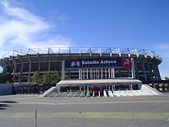
Sport - Football
Mexico's home stadium is the Estadio Azteca
and their head coach is Miguel Herrera.
The team is currently ranked 19th in the
FIFA World Rankings and 15th in the World
Football Elo Ratings.
Mexico has qualified for fourteen World Cups
and has qualified consecutively since 1994,
making it one of only six countries to do so.
The Mexican national team along with Brazil and
Germany are the only three nations to make it
out of the group stage over the last five World
Cups.
Mexico played against France in the very first
match of the first World Cup on 13 July 1930.

Slide 8
National Football Team
Good Luck!

