Slide 1
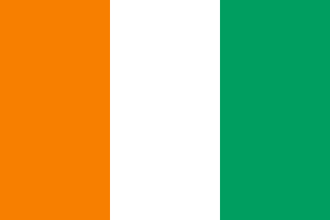
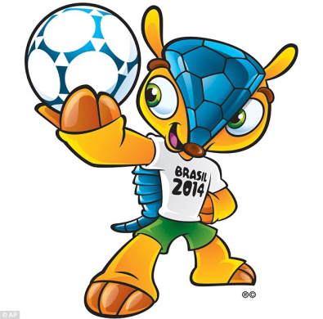
2014 FIFA Wolrd Cup Brazil
Côte d'Ivoire

Slide 2
Geography
Ivory Coast (French: Côte d'Ivoire) officially the Republic of Ivory Coast (French: République de Côte d'Ivoire), is a country in West Africa.
It borders Liberia,
Guinea, Mali, Burkina Faso,
and Ghana. Its southern
boundary is along
the Gulf of Guinea.
The capital city is
Yamoussoukro and the
biggest city is the port city
of Abidjan.

Slide 3
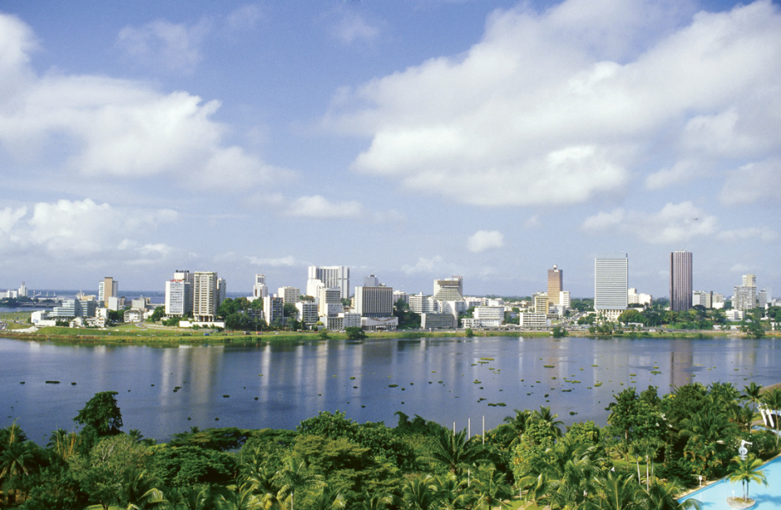
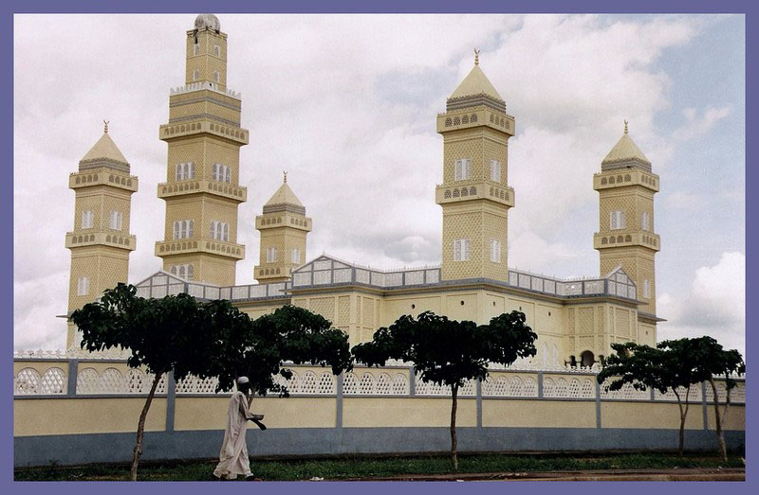
Population is about of 22,400,835.
Currency – West African CFA franc.
Language – The official language is French, although many indigenous local languages are widely used, including Baoulé, Dioula, Dan, Anyin and Cebaara Senufo.
Bandama River is the Longest
River in Ivory Coast

Slide 4
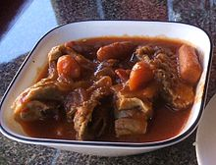
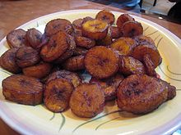
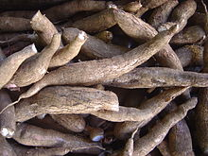
Ivorian Cuisine
Traditional cuisine is based on tubers, grains, chicken, seafood, fish, fresh fruits, vegetables and spices.
Common staple foods include grains and tubers. Côte d'Ivoire is the largest producer of cocoa in the world, and also produces palm oil and coffee.
Kedjenou
Alloco (fried banana)
Raw cassava

Slide 5
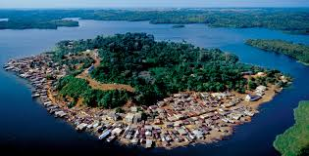
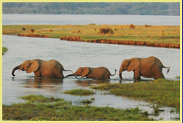
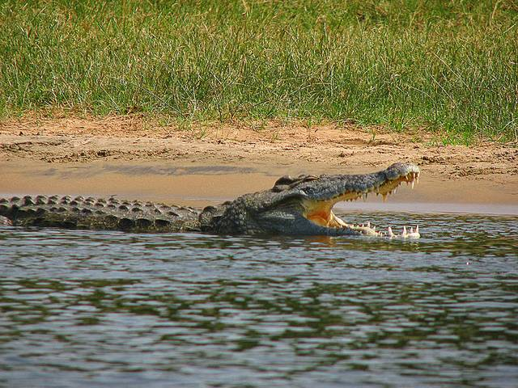
Interesting Places
Assouinde
Tiagba
Comoé National Park

Slide 6
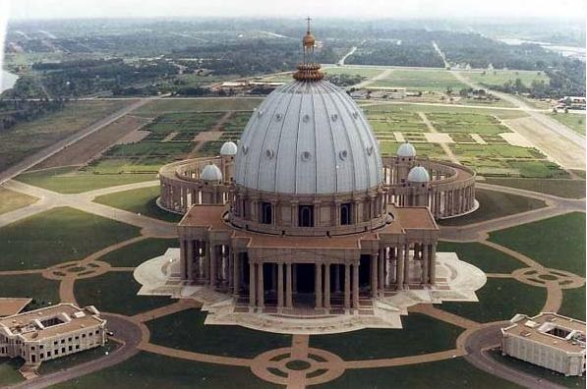
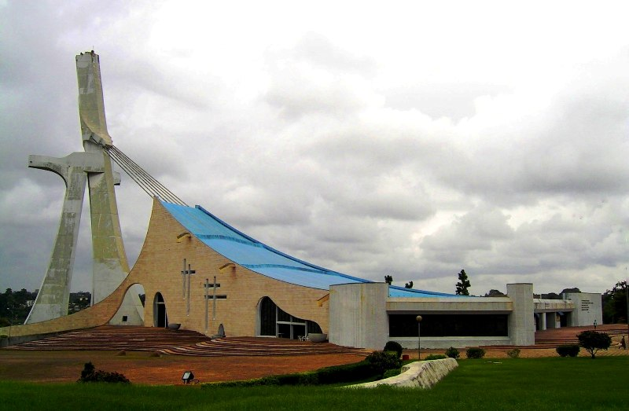
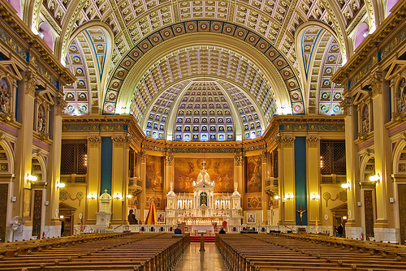
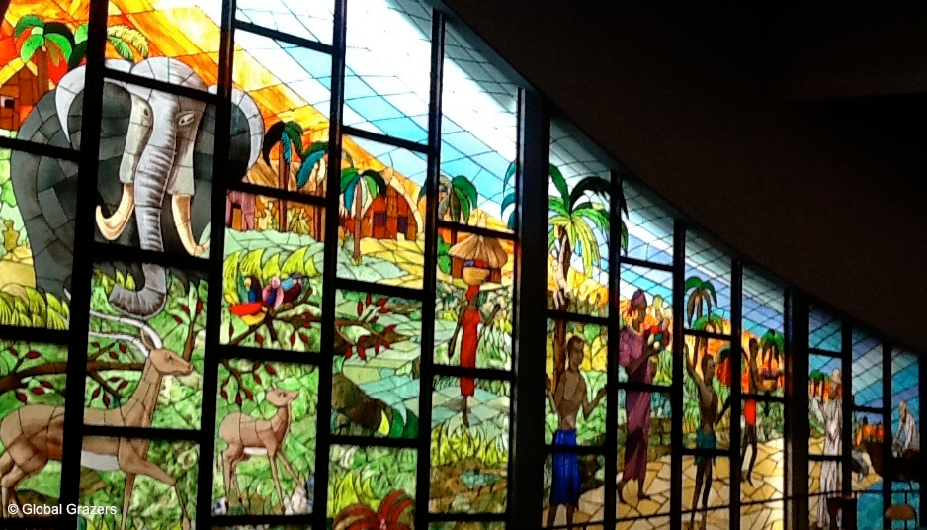
Basilica of Our Lady of Peace
in Yamoussoukro
St. Paul’s Cathedral
in Abidjan
(Largest Church in the World)

Slide 7
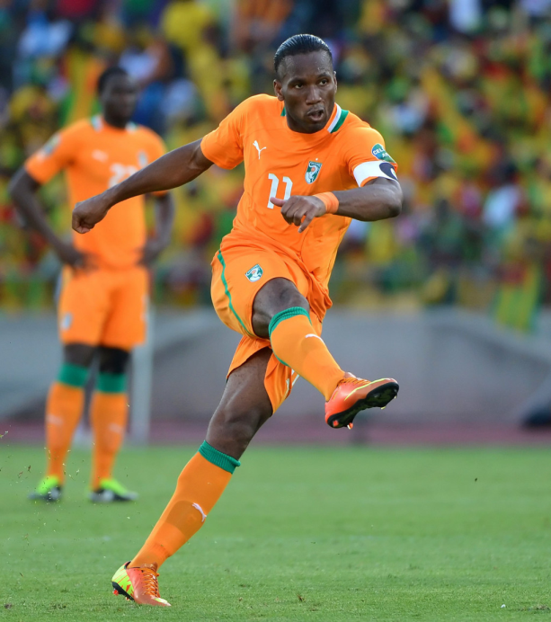
FIFA World Cup 2014
The most popular sport in Ivory Coast is football. The Ivory Coast national football team nicknamed Les Éléphants (The Elephants), has played in the World Cup in Germany 2006, in South Africa 2010 and now in Brazil. The team coach is Sabri Lamouchi.
Côte d’Ivoire boast some of the greatest individual talents in Africa. Forwards Didier Drogba and Salomon Kalou are a formidable front pair, while midfield duo Cheick Tiote and Yaya Toure perform key ball-winning duties in
the middle of the park.
FIFA currently ranks
Ivory Coast first
among African nations.
Didier Drogba, captain of
the National Football team.

Slide 8
National Football Team
Good Luck!

