Slide 1
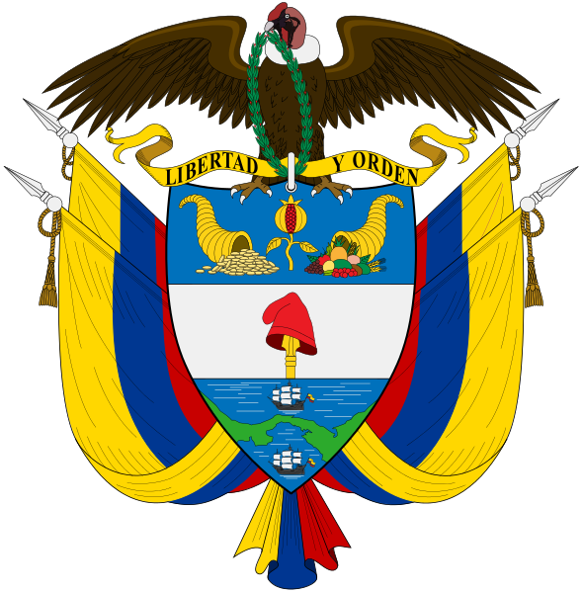
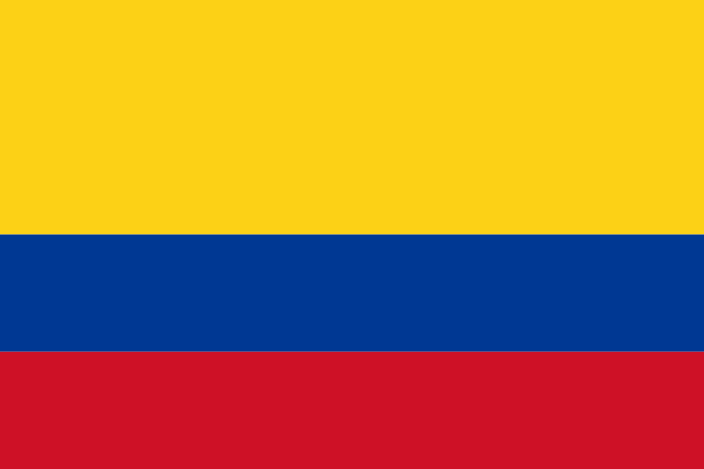
Space Teds’ Adventures Around Europe World Cup research
colombıa

Slide 2
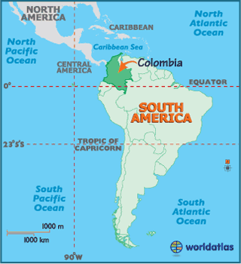
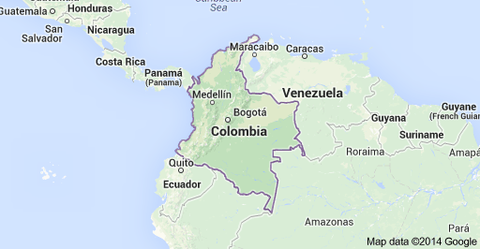
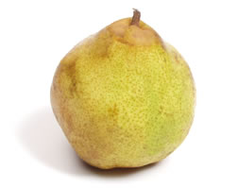
LOCATION
Shaped like an odd-looking pear with a thin top, Colombia is located in the northwestern corner of South America, alongside the Caribbean Sea between Panama and Venezuela, and bordering the Pacific Ocean between Panama and Ecuador.

Slide 3
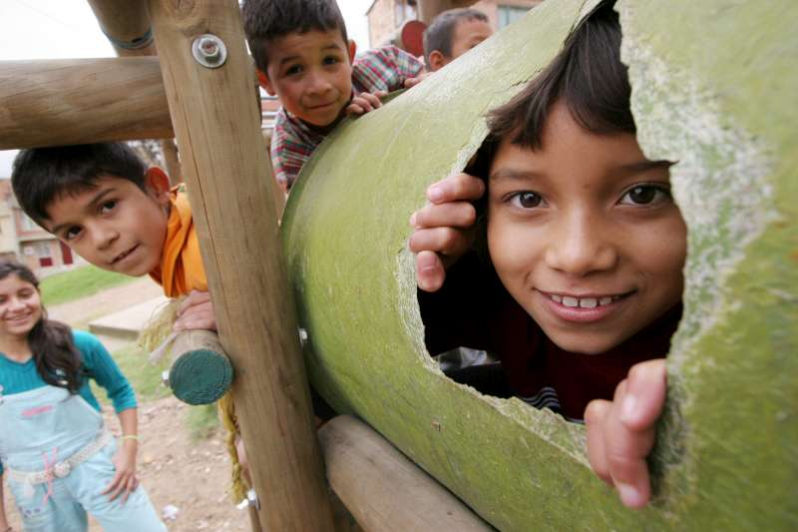
POPULATION
Its population was estimated at 39.68 million in July of 2000, up from 25.4 million in 1975. In 2000 the birth rate stood at 22.85 per 1,000 while the death rate was 5.73 per 1,000. With a projected annual growth rate of 1.6 percent between 2000 and 2015, the population is expected to reach 53.2 million by the year 2015.

Slide 4
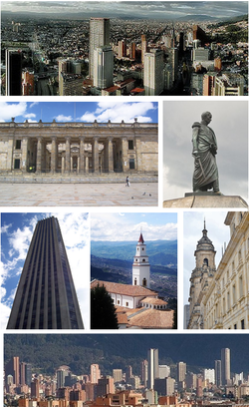
CAPITAL CITY: BOGOTA
Bogota is the capital and largest city of Colombia. About 8 millions of people live in this city.
The city lies at 2600 meters altitude on a mountain plateau in the eastern mountains of the Andes.

Slide 5
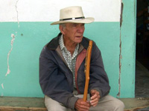
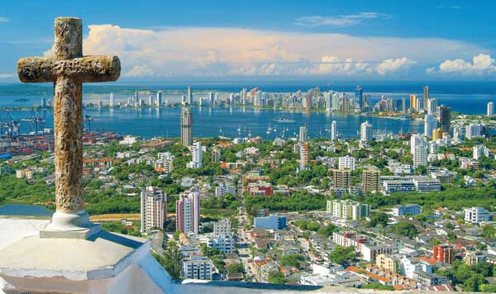
LANGUAGE & RELIGION
Spanish is the official language of Colombia. English is commonly spoken on the islands of it. 65 indigenous languages and over 300 dialects are also spoken within Colombia's borders.
About 90% of Colombians are Roman Catholic. They influenced by other cultures beliefs but in a small minority.

Slide 6
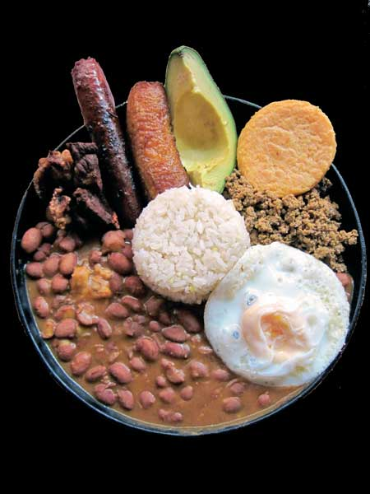
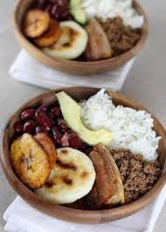
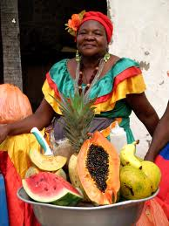
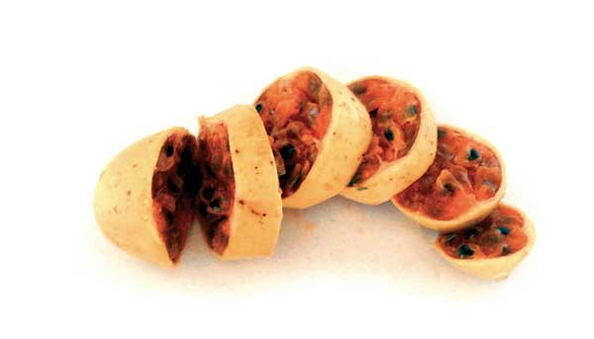
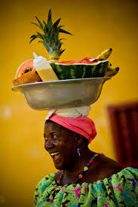
FOOD
Colombian food is essentially Creole and is quite varied - ranging from guinea pig to lobster. A typical lunch or dinner in Colombia consists of meat or chicken served alongside frijoles (kidney beans) or lentils, fried plantain, rice and a small salad. Coffee is tasty and ubiquitous. But the fruit of Colombia is both extremely varied and delicious.

Slide 7
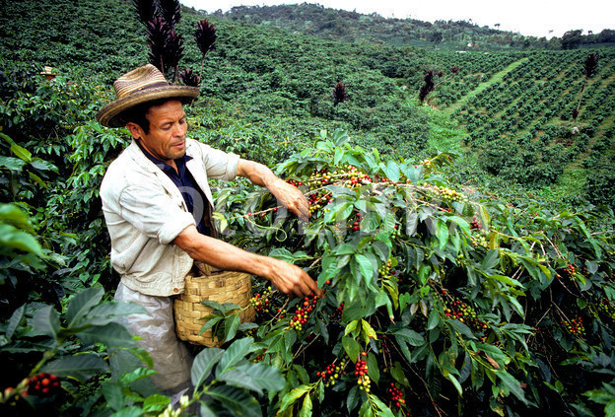
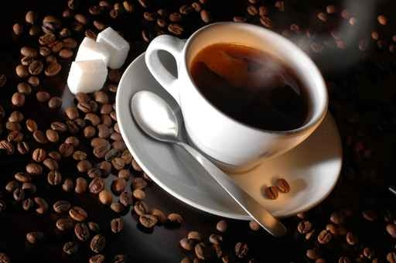
COLOMBIAN COFFEE
Colombian coffee is often regarded as some of the highest quality coffee in the world. Colombia has traditionally grown arabica beans and its unique geography makes it perfectly delicious.

Slide 8
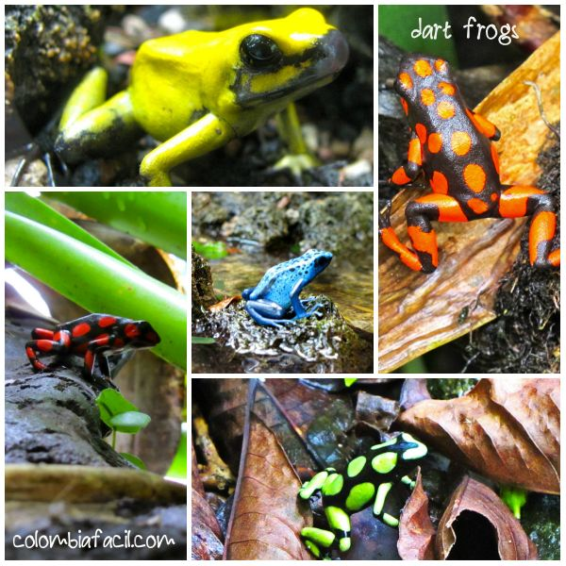
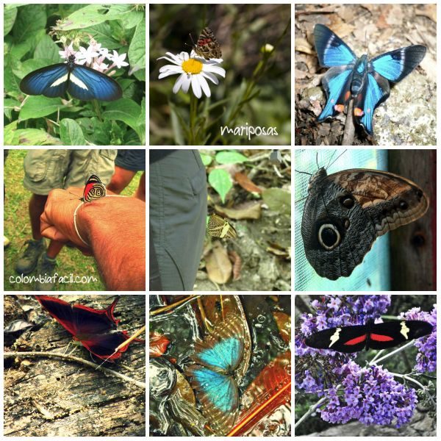
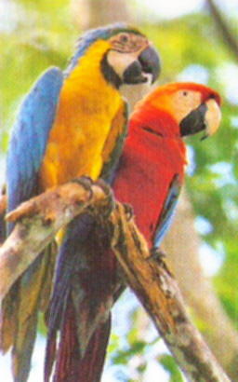
FAUNA & FLORA
Thanks to its geographic location(Amazon Forests) and its topography, Colombia stands out with its bio diversity around 130.000 plants of which approximately the half are endemic; and a collection of flowers that exceeds 50.000 species. It takes up the first place in diversity of birds with more than 1.700 species, that is 18% of 9.000 existing. .

Slide 9
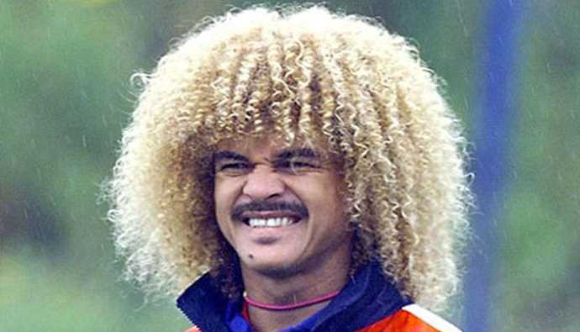
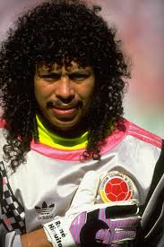
COLOMBIAN FOOTBALLERS
CARLOS VALDERRAMA is known one of the best footballer of South America and there are some wel-lknown Colombian footballers such as Carlos Valderrama, Rene Higuita, Radamel Falcao, and Ivan Cordoba.

Slide 10
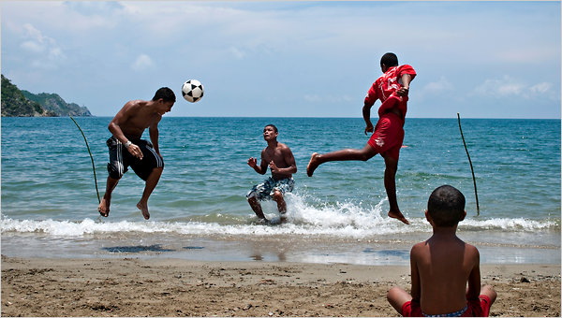
THANK YOU!! Prepared by: Ahmet Fevzi Özdemir & Doğukan Emre Ok SAKARYA TURKEY 2014

